Slide 1

“Opportunities dances with those who are already on the dance floor”
Agnieszka Maria Gasperini
PMI REGION MENTOR, Central Europe
Notes:
Please add your notes here

Slide 2

1997
95% Membership
93% PMPs
4% Membership
3% PMPs
0.25% Membership
3.5% PMPs
0.75% Membership
0.5% PMPs
31,333 Total Members | 6,119 Certification Holders | 96 Countries

Slide 3
2015
60.3% Membership
46.9% PMPs
15.3% Membership
13.7% PMPs
17.5% Membership
34.3% PMPs
6.9% Membership
5.1% PMPs
476,000 Total Members | 679,000 Certification Holders | Every Country

Slide 4
Global Chapters
162 Chapters
41 Chapters
42 Chapters
10 Chapters
5 Chapters
32 Chapters
Staff Supported Offices

Slide 5


Notes:
5
5
5

Slide 6
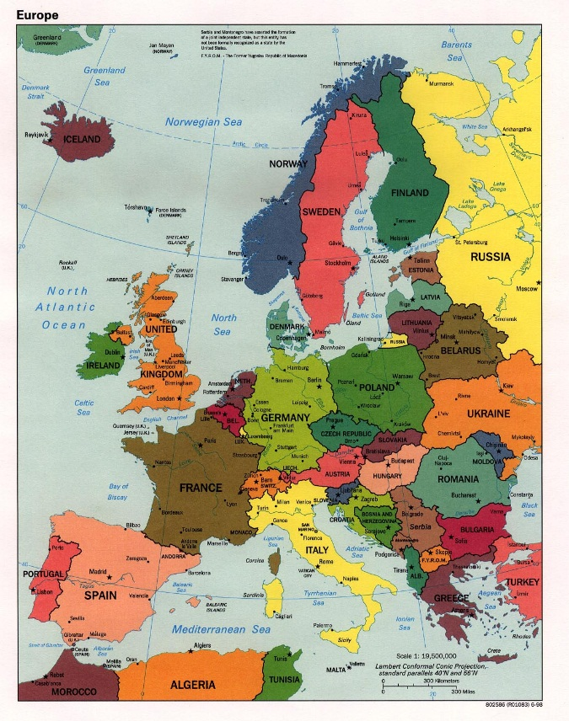
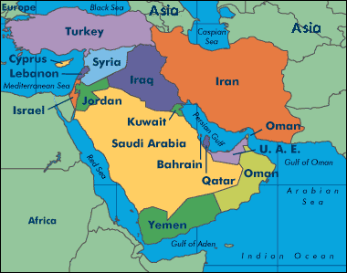
EMEA PMI Chapters
Europe: 41 chapters
  North West Europe (15 chapters)
  South West Europe (11 chapters)
  Central Europe (10 chapters)
  Eastern Europe (5 chapters)
            Middle East: 6 chapters
            Africa: 7 chapters
Notes:
Chapters come in varying sizes designed to best suit the needs of local members:
City
National

Slide 7
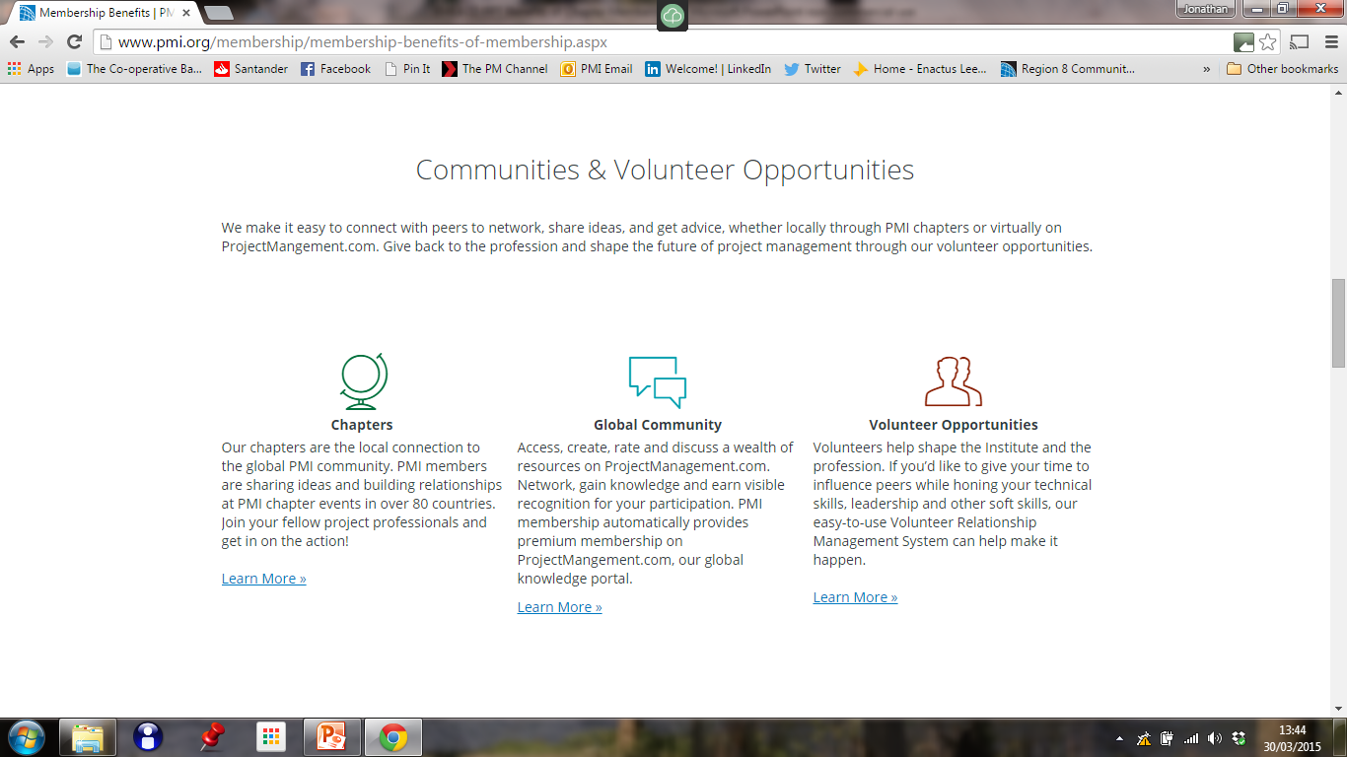
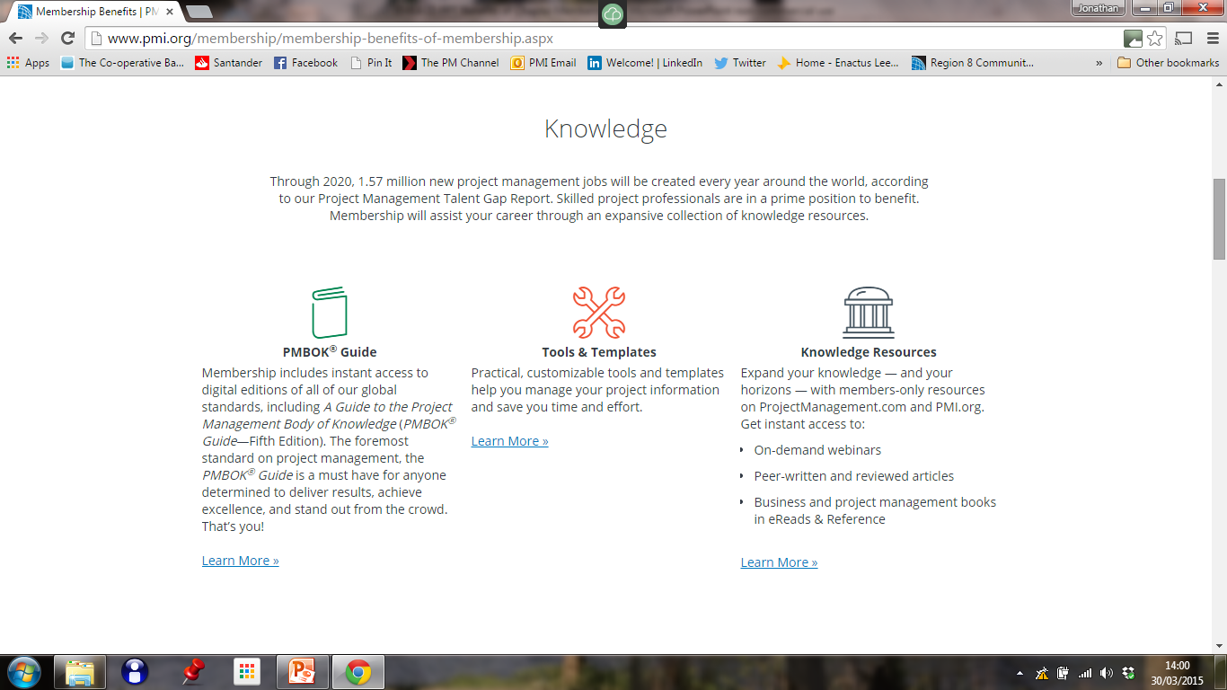
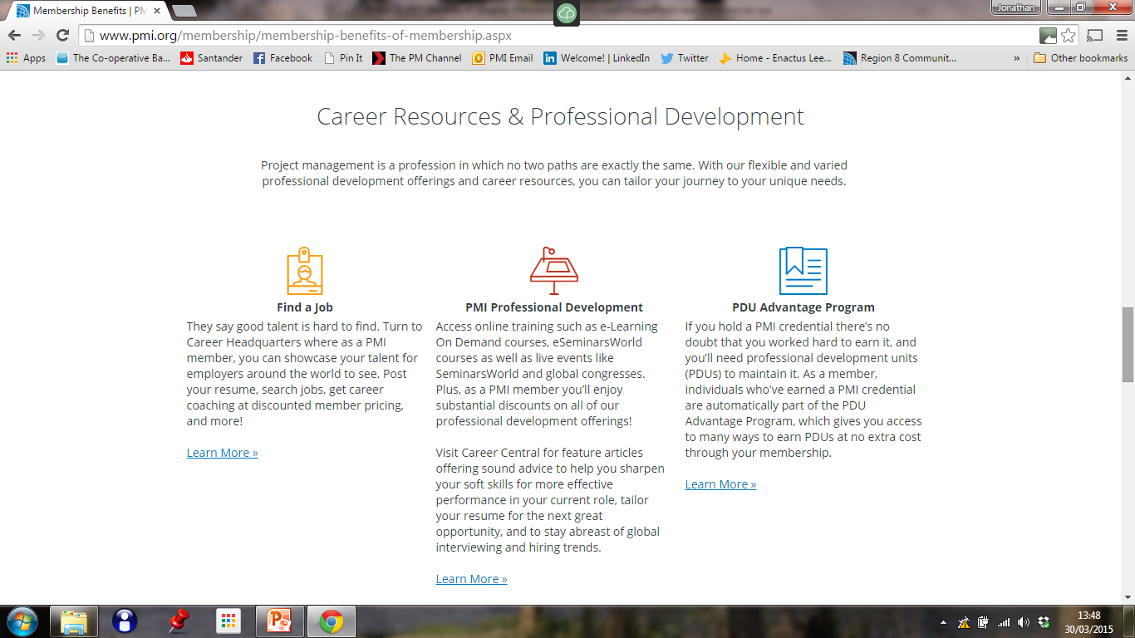
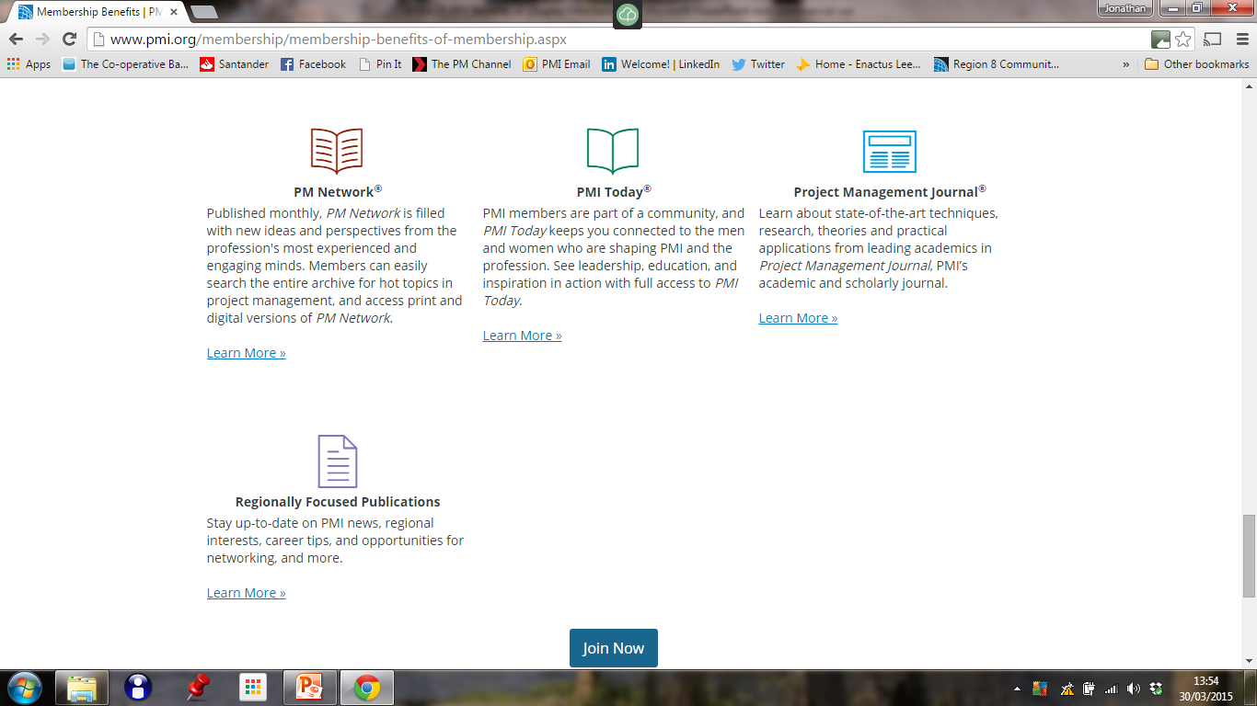
Benefits of PMI Membership
Communities and volunteer opportunities
Knowledge
Rewards and discounts
Career resources and professional development
Publications
Notes:
Talk through member benefits at a high level.
Communities underpin everything PMI does and one of the most important member benefits. Projectmanagement.com provides a global community where you can network with similar professionals. Chapters provide local communities to meet local needs. Chapters actually provide more depth to all the other benefits. They offer their own programmes that are distinct to the Chapter. Today we are going to focus on what Chapters are.

Slide 8
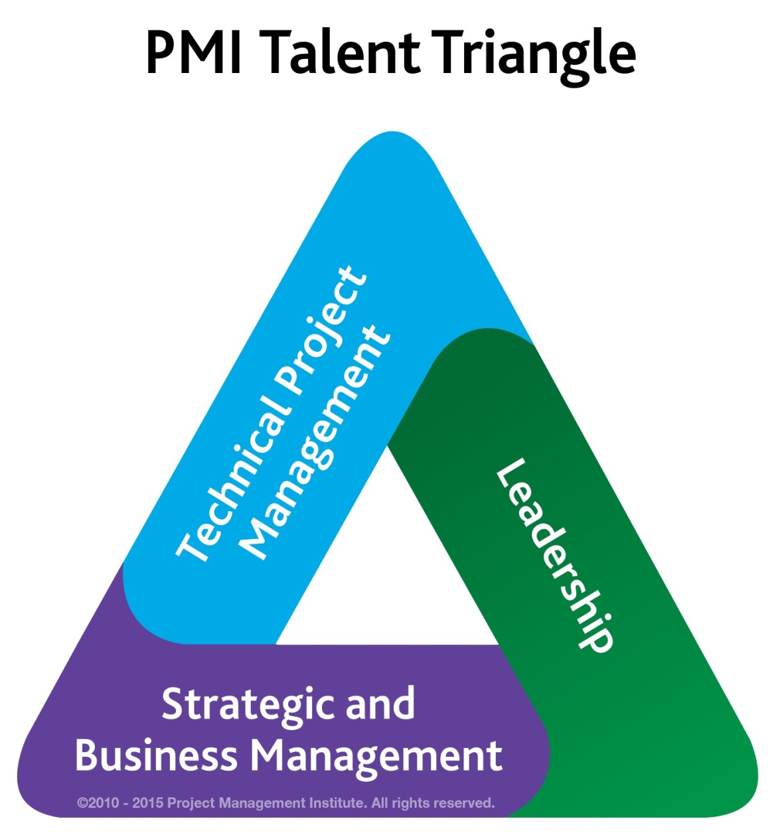
Development and Recognition
PROFESSIONAL
DEVELOPMENT
ONLINE LIBRARY
CREDENTIALING
PROGRAM

Slide 9

The World Economic Forum on the global outlook for 2015 identified the lack of leadership as the
no.3 challenge over the next 12-18 months.

Slide 10

Study RESULTS:
crucial leadership skills in organizations are
insufficient for meeting current and future needs.
Center for Creative Leadership (CCL®):
2,239 leaders; 24 organizations; 3 countries
Study RESULTS:
recommendations for organizations seeking to assess
and bridge the gap between where they are and where they
need to be in few months.
APQC - business benchmarking, best practices, and knowledge
management research.

Slide 11

TODAY SKILLS
Inspiring commitment
Building collaborative relationships
Change management
Taking initiative
Leading employees
“The current
leadership deficit”

Slide 12

FUTURE SKILLS
Inspiring commitment
Leading employees
Strategic planning
Change management
Most important
Future Skills

Slide 13
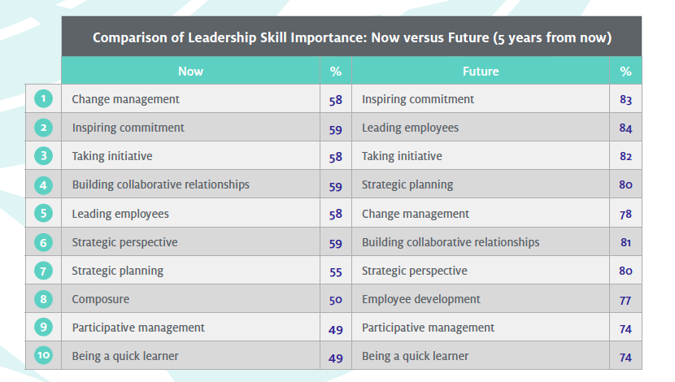

Slide 14

To increase leadership capacity,
organizations need to take
both a strategic and a tactical approach.

Slide 15

FUTURE SKILLS

Slide 16
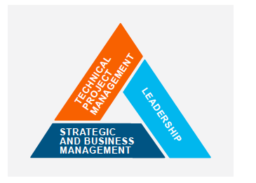
Leading employees
To develop this skill, YOU need to:
Communicate the specific behaviors and skills
Assess leaders on the key behaviors and skills
Create training and development programs
Develop internal groups to share experiences
Foster a FEEDBACK

Slide 17
Strategic planning
Translate vision into realistic business strategies
To improve this skills, organizations might:
            Share the strategy
            Teach strategic skill
            Involve all managers in
            strategy development
            Expose managers to new skills
            Support learning –
            mentoring & coaching

Slide 18

Inspiring commitment
Organizations can strengthen this skills by:
Clarifying the vision
Passing it on – communicate
Raising standards
Reinforcing success

Slide 19
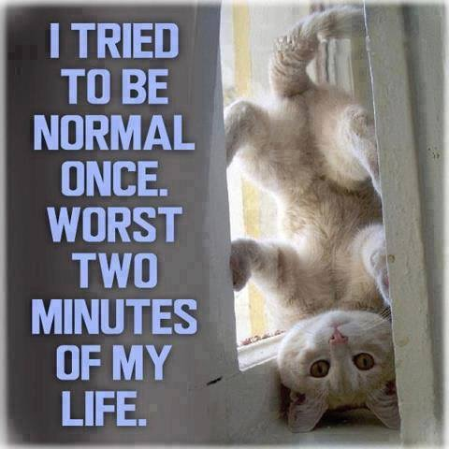
Change management
To develop this skill organizations may:
Change management classes
Involve others in change decision making
Create a “space” for creative ideas
Develop strategies to deal with change resistance

Slide 20

Employee development
To develop the skill:
Regular career goal discussions
Develop a succession planning

Slide 21

Self - awareness
To improve this skill:
Implement a 360-degree
Assessments
Mentoring program
Adopt best practices

Slide 22


Slide 23

Q&A

Slide 24
Contact information
Agnieszka Gasperini, PMP, PMI-ACP, SDI
agnieszka.gasperini@mentor.pmi.org
LinkedIn: www.linkedin.com/in/agasperini
Italy: +39 (347) 398.8847
Poland: +48 (69) 649.9996

