Slide 1


Workshop:
PM Shift Talks
Creative Shower
20 November 2015

Slide 2


Rene Tomova
@renetomova rene@creativeshower.net www.creativeshower.net Sofia, 20/11/2015
Hell

Slide 3
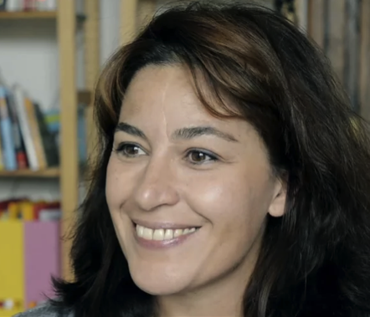
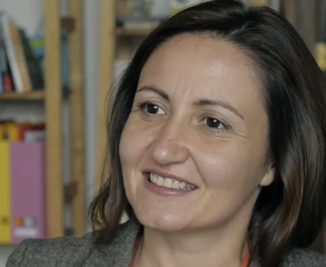
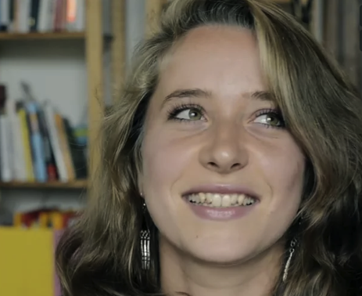
Kalina Zhuleva Rene Tomova Lora Todorova

Slide 4
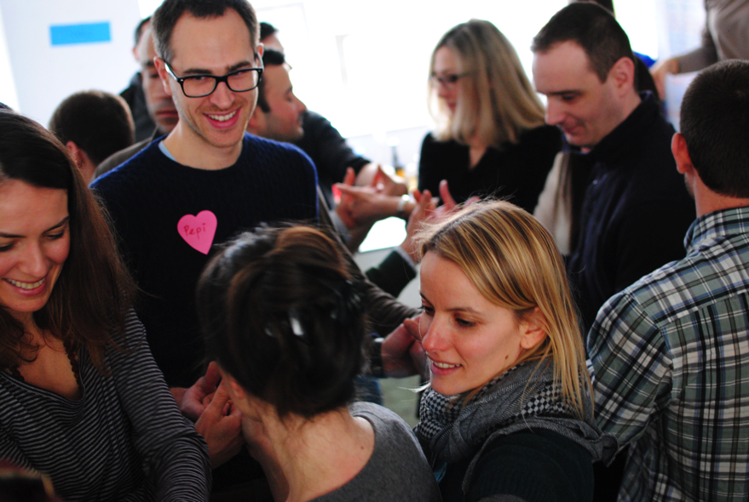
Why we do what we do
We believe that if you drop the rigid rules, you can achieve much more and be happier.
We believe that people deserve to live a meaningful life.
We believe in asking questions.
We believe that everyone is
creative.
We believe in sharing.
We believe that openness
transforms people, organizations
and societies.
We believe in people.

Slide 5
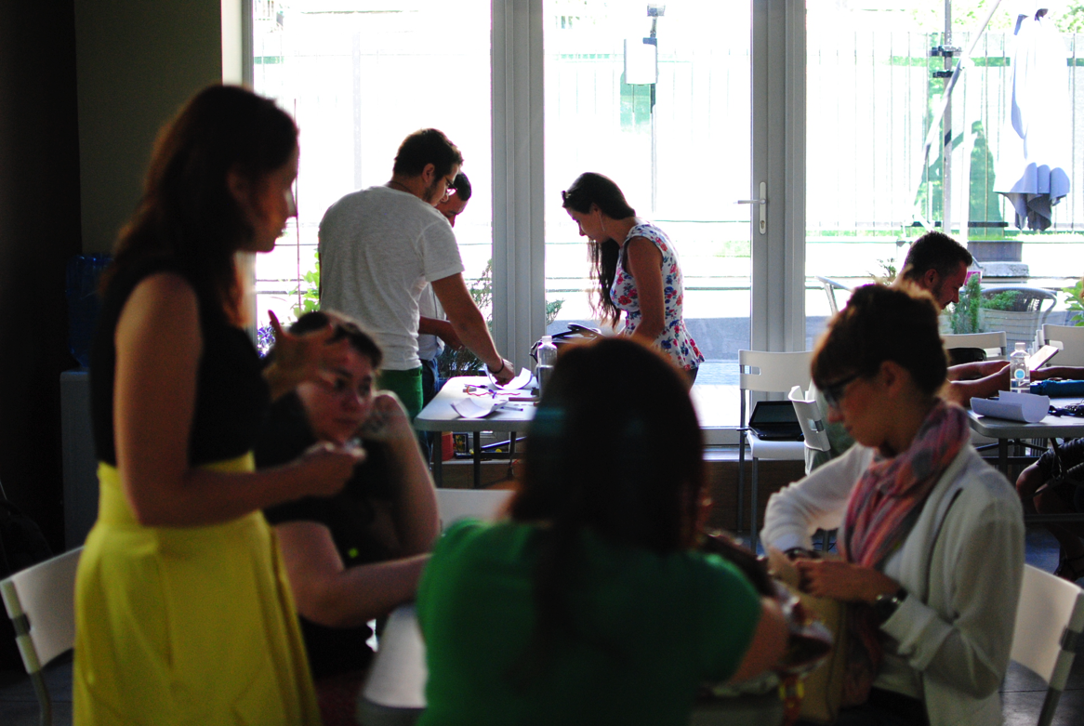
How we do it
We created our own model for helping organizations grow and develop in a sustainable way. It thrives on creativity, inspires innovation, and is driven by co-creation.

Slide 6
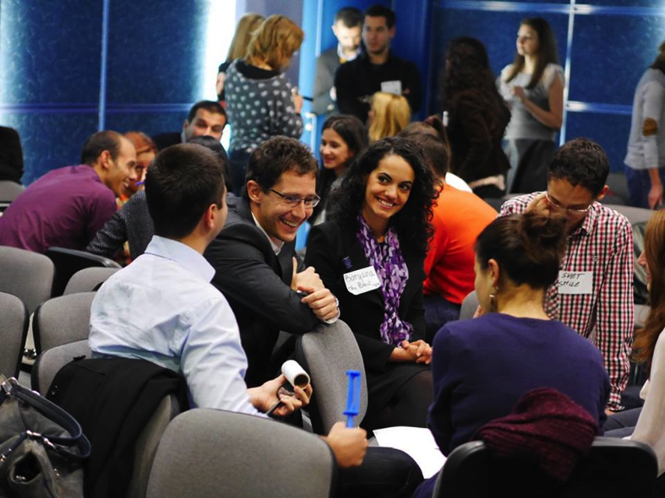
Our work principles
Co-creation with your customers and stakeholders is the basis for creativity and success.
Current complex challenges cannot be tackled in a standard way.
Innovation is more about culture and mindset and is not a one-time effort.
  Workshops
  Interactive lectures
  Product/service design sprints
  Problem-solving sessions
  Events
  Design thinking camps
  Creativity bursts
  Consulting projects
  You can check out our services at www.creativeshower.net/services

Slide 7

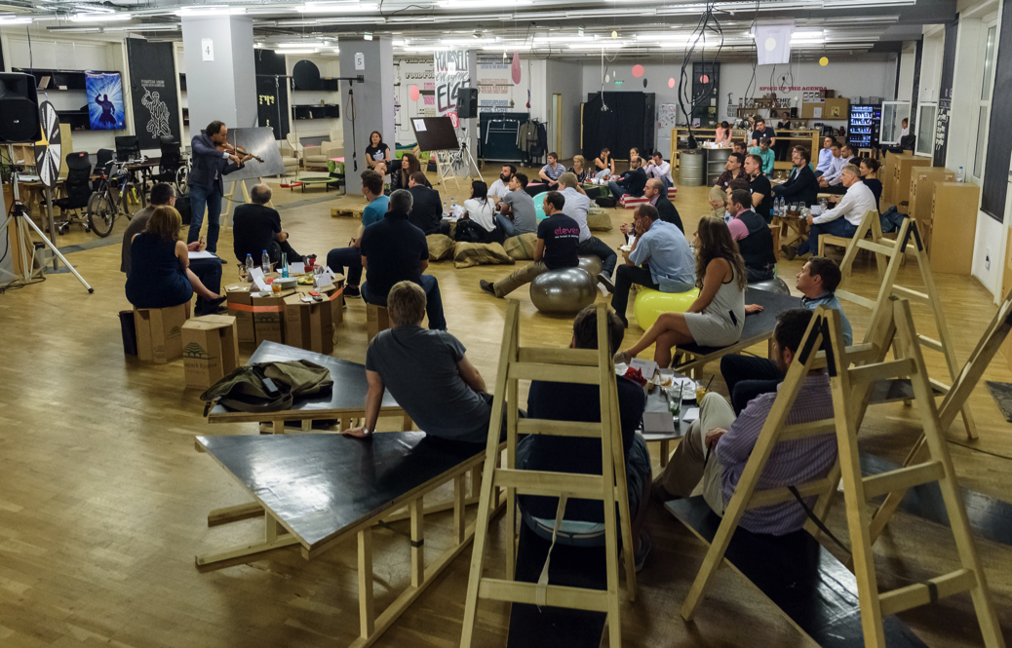
Change. Challenge. Opportunity.

Slide 8

THE FORMAT
Talk #1 (5-7min)
Discussion at the tables (10-15min)
Sharing and capturing impressions (10-15min)
Shuffle and change places (~5min)
Talk #2 (5-7min)
Discussion at the tables (10-15min)
Sharing and capturing impressions (10-15min)
Shuffle and change places (~5min)
Talk #3 (5-7min)
Discussion at the tables (10-15min)
Sharing and capturing impressions (10-15min)

