Slide 1
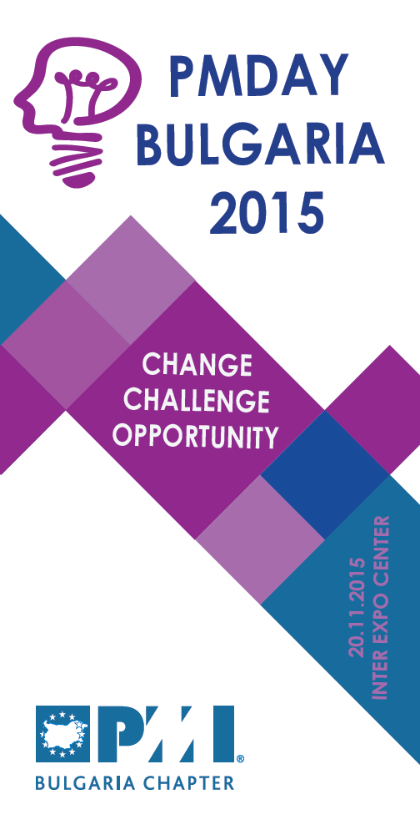

Next Generation Project Managers: Success Tips for
Getting Ahead and Working Together
Kamil Mroz
Managing Director, European Centre for Project Excellence
20 November 2015

Slide 2








Who am I

Slide 3
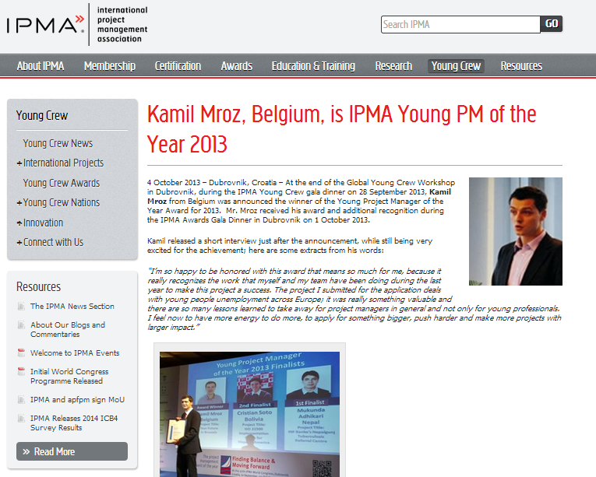
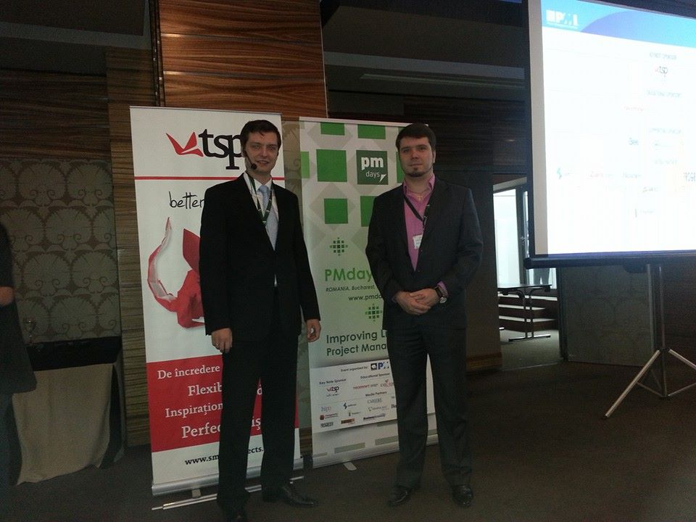
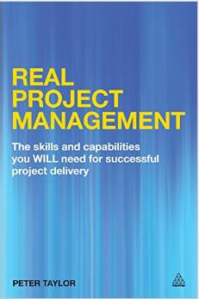

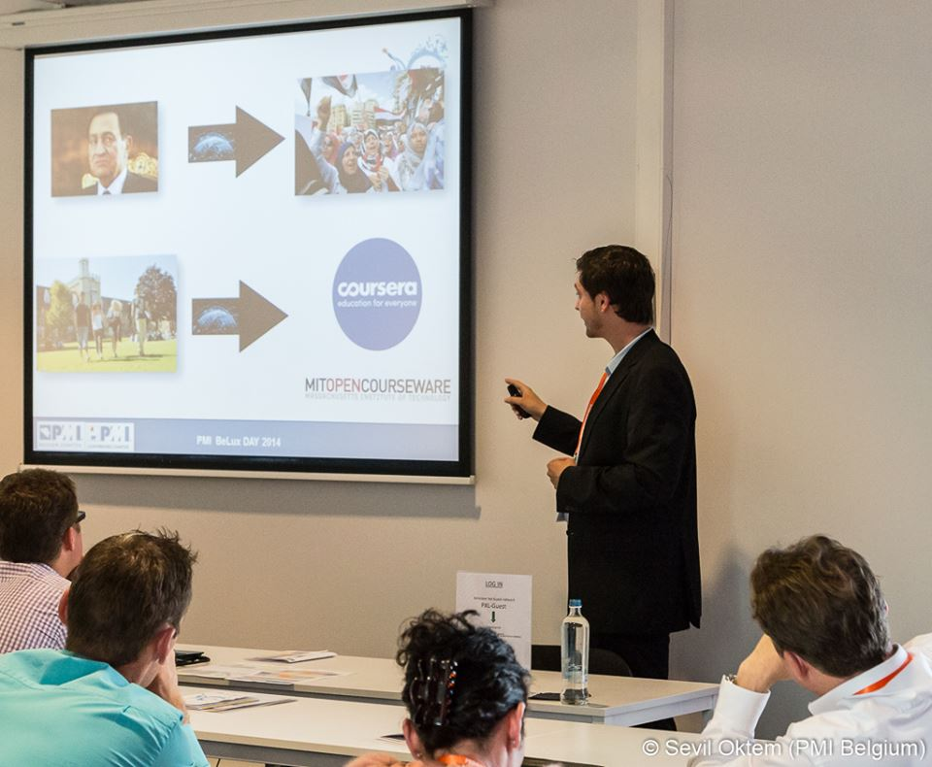

Slide 4

Setting the Scene….

Slide 5

Characteristics of the 21st Century

Slide 6

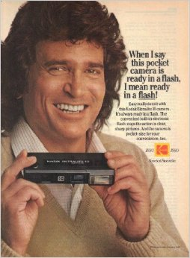

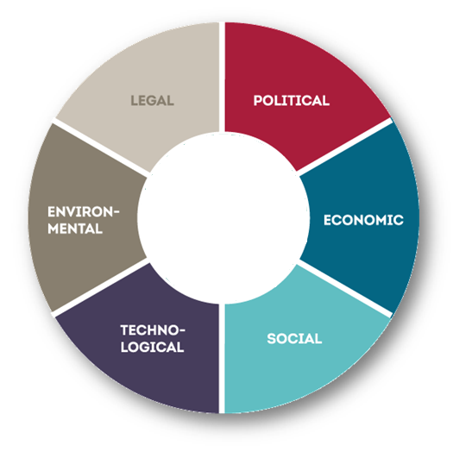

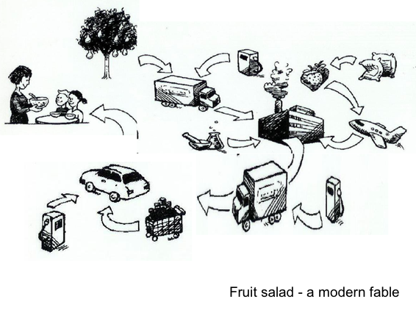
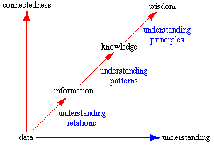

Diversity
Ambiguity
Complexity
Rapidly Changing
Interdependent

Slide 7
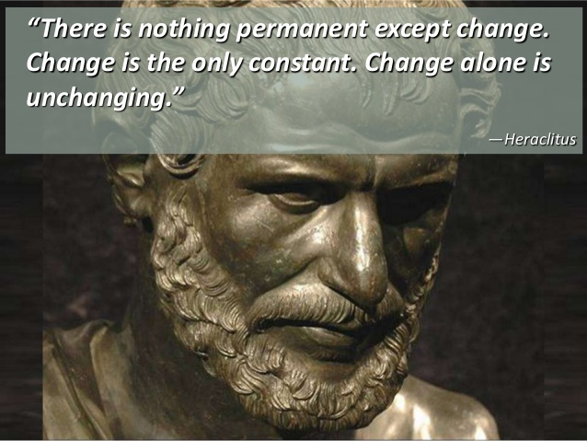

Slide 8

Projects are Change
PMI (website, not PMBOK)
  “A project is temporary in that it has a defined beginning and end in time, and therefore defined scope and resources.”
PRINCE2
  A Project is a temporary organization that is created for the purpose of delivering one or more business products according to an agreed Business Case.
IPMA
  “A project is an endeavor that produces a clearly specified product, service, or result in a limited period of time within a limited budget.”

Slide 9
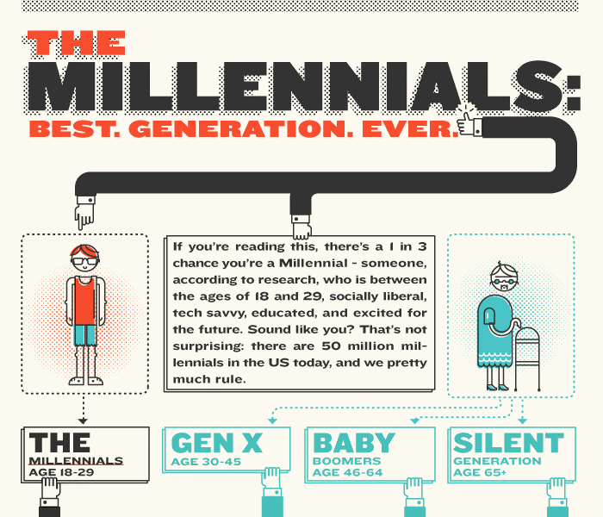
Notes:
4 Ways to Recruit and Retain Millennials
Keep young practitioners engaged so they’re less likely to jump ship.
8 July 2014
Project management is booming, and millennials hammered by the recession are flocking to the profession. Three in five hiring managers say interest in project management careers among younger job applicants has jumped over the past decade, according to PMI’s 2013 Pulse of the Profession® study.
So how do organizations find (and keep) the cream of the crop? Making the wrong call could hurt. Approximately 60 percent of millennials globally exit their companies in under three years, with 87 percent of organizations reporting costs of up to US$25,000 to replace each lost employee, according to a 2013 survey by research firm Millennial Branding.
Organizations can make the most of the millennial project talent pool with these tips:
1. Go straight to the source. Instead of weeding through online applications, Michael Ferreira, PMP, heads right to millennial hotspots like universities, entrepreneurial incubators, industry get-togethers and Twitter. Directly engaging with younger practitioners allows him to observe their communication and leadership skills, while also sending a signal that he’s interested, says Mr. Ferreira, project management consultant at ShawCor, an energy services company in Toronto, Ontario, Canada.
Talent scouts can keep the conversation going by interviewing young candidates on a rolling basis, says S. Slade Sundar, COO at Forte Interactive, a web solutions company in West Palm Beach, Florida, USA. Then, when a position does open, organizations have a jump-start on the brightest stars.
2. Show them their very own path. Once they’re in the door, a defined career path and ongoing training helps keep young employees interested and also benefits the organization. For example, 77 percent of high-performing organizations — those that complete 80 percent or more projects on time, on budget and meeting original goals — have ongoing project management training, while 62 percent of high performing organizations define a career path for project managers according to PMI’s 2014 Pulse of the Profession®report.
“As long as they have enough money to take care of their daily needs, millennials are predominantly looking for opportunities to grow and contribute,” says Susanne Madsen, project management consultant at Susanne Madsen International Ltd., London, England. “What really motivates and retains them are professional opportunities.” In other words, millennials are looking for employers to help them develop their careers.
3. Bring them into the fold. “[Millennials] are used to being involved in decisions that affect them,” Ms. Madsen says. So organizations should try to make them part of relevant conversations and provide opportunities to lead and work autonomously.
One option is for organizations to cross-train millennials and give them mini projects to head up, along with their regular support responsibilities. Foster an environment in which they can explore what direction they want their career to go by actually trying out tasks related to a specific direction, Mr. Sundar says.
4. Be open to rehiring. Sometimes you have to thin the ranks and let millennials go, Mr. Ferreira says. But organizations must know how and when to reel them back in, especially in an age when most employees don’t remain at one company for their entire career.
When young stars leave his company on good terms, Mr. Sundar follows their careers and keeps in touch. “We still have them come to company happy hours,” he says of those who depart. “And I would hire any of them back at a moment’s notice if there was a fit for a position at that time.”

Slide 10
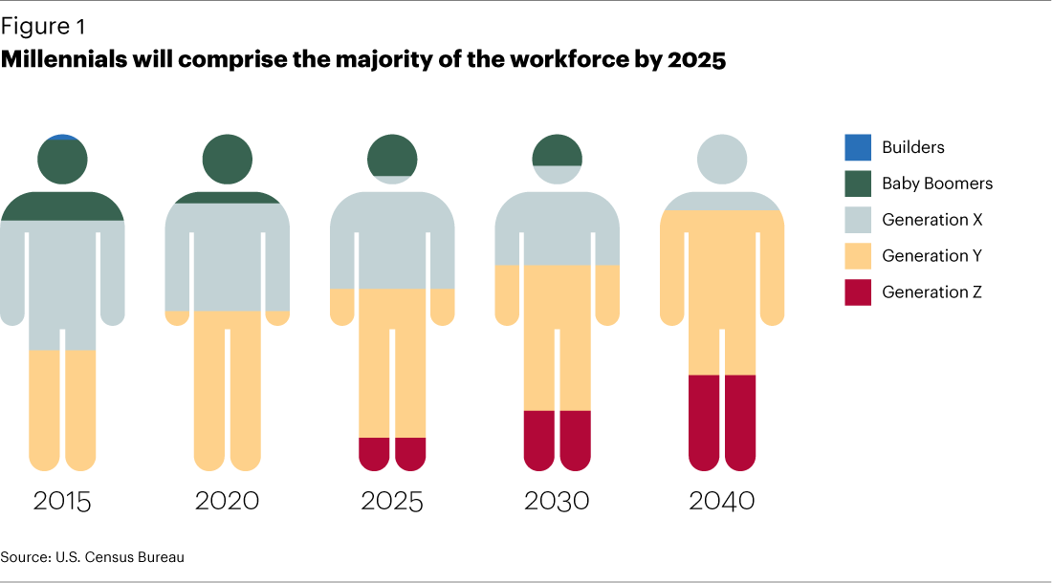
91% of Millennials (born between 1977-1997) expect to stay in a job for less than three years, according to the Future Workplace “Multiple Generations @ Work” survey of 1,189 employees and 150 managers. That means they would have 15 – 20 jobs over the course of their working lives!

Slide 11


Slide 12









Project Management Career Paths
Notes:
Since there will be more and more PM jobs, it’s important to adapt your organizational capabilities to adapt to this need. That is, career paths for young people to follow as project managers, and promoting Project Management career development paths with the appropriate levels to retain top talent. This requires consideration at the highest level to re-define organizational strategies to ensure that this is taken into consideration. The challenge is that at all levels of the organization this project management consideration is taken into place:
Business Vision and Strategy
Organizational strategy and competency alignment
Individual assessments to evaluate individual performance
Build Tailored capability development
Deliver trainings
Embedding into the organization
Feedback and results review

Slide 13


Slide 14


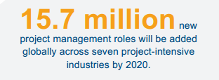
Opportunities for Millennials to be Project Managers
Notes:
Through 2020, 1.57 million new project management jobs will be created every year worldwide.
We are seeing more and more companies bring on project and programme managers to handle the big tasks of project that are coming up that require someone to come in and oversee them.
Between 2010 and 2020, 15.7 million new project management roles will be created globally across seven project-intensive
industries. Along with job growth, there will be a significant increase in the economic footprint of the profession; the project
management profession is slated to grow by USD$6.61 trillion. This enormous anticipated growth, along with higher-than average
salaries, will make the next seven years an opportune time for professionals and job-seekers to build project management skills.

Slide 16

Moore’s Law: is the observation that, over the history of computing hardware, the number of transistors in a dense integrated circuit has doubled approximately every two years

Slide 17
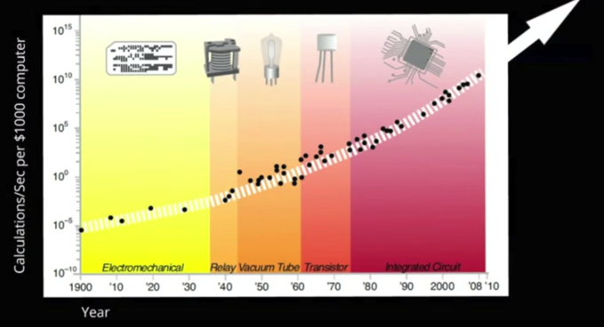
The rate at which technology is getting faster is in fact getting faster….!

Slide 18




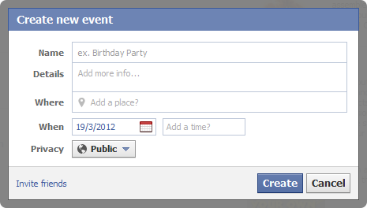



Slide 19
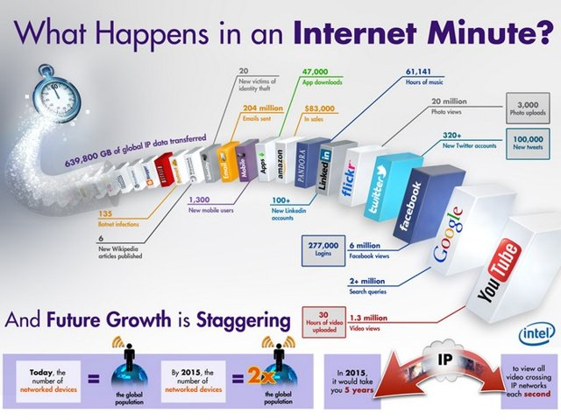
Notes:
We often talk about how the growth of internet is explosive and how soon the whole world will be hooked to this medium. But words can not procure it as effectively as this infographic by Intel does. According to the infographic, netizens make some 2 million Google searches and 100,000 tweets every minute.
And that’s literally just the tip of the iceberg. Even with millions of people tooling a smartphone, it is indeed surprising that 47,000 apps are downloaded each minute. Moreover, the power of the open-source is also well manifest in the fact that every single minute, 6 new Wikipedia articles are published – guess we never will be able to read that encyclopaedia in its entirety.
Facebook takes the lead when it comes to the social media front. Every minute, 277,000 logins are made to the social network with 6 million views. 30 hours of video are uploaded to YouTube and 1.3 million views pour in within that minute. Twitter is close on the heels of Facebook with its 100,000 tweets and 320 new Twitter accounts per minute.

Slide 20
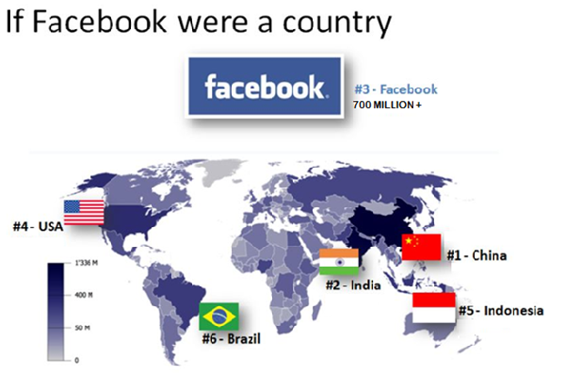

Slide 21

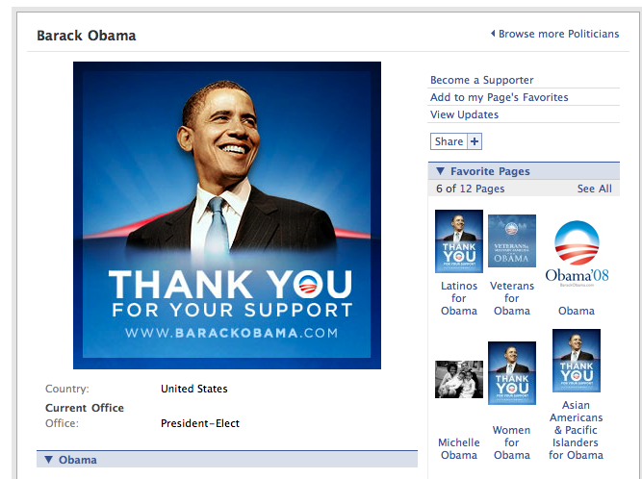
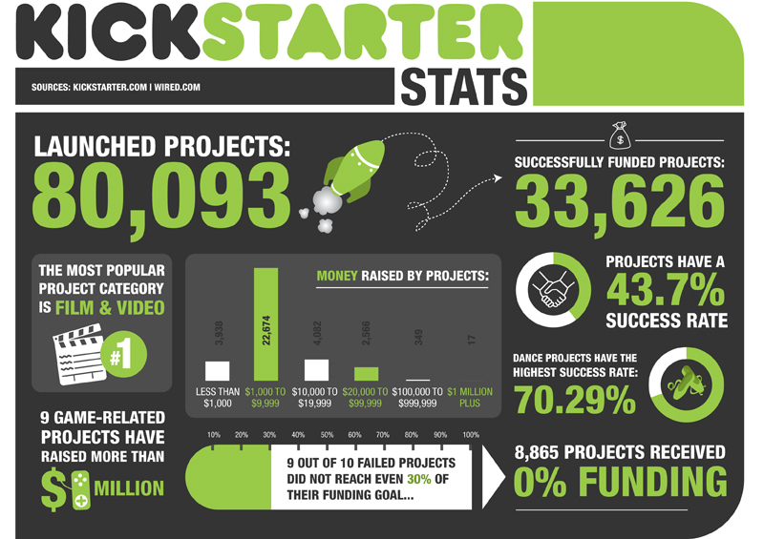


Slide 22

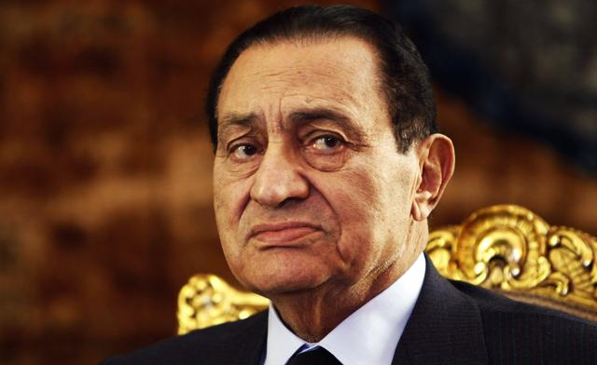



Notes:
If everything goes according to plan, Laurie Pickard, 32, will earn her MBA in three years for less than $1,000. She’ll take classes from Stanford, Wharton, and Yale, among other top-tier schools. And she’ll tackle it with $0 opportunity cost by keeping her full-time job as a rural enterprise development and entrepreneurship specialist at USAID. She’ll accomplish all of this from Kigali, Rwanda.

Slide 23
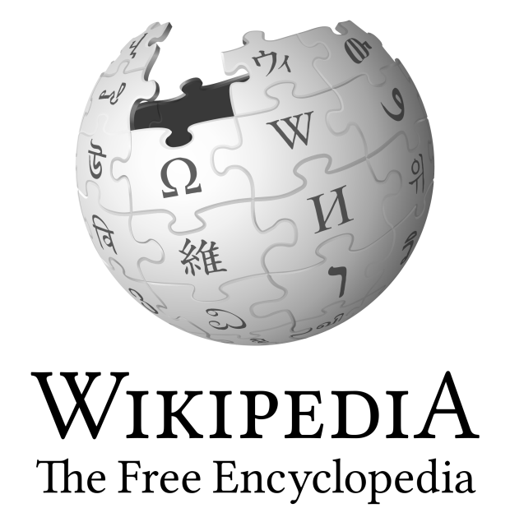


Slide 25


Slide 26
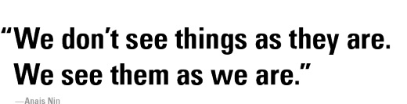

Perception
Notes:
"Perception involves all the ways of becoming aware of things, people, happenings, or ideas. Judgment involves all the ways of coming to conclusions about what has been perceived. If people differ systematically in what they perceive and in how they reach conclusions, then it is only reasonable for them to differ correspondingly in their interests, reactions, values, motivations, and skills."
Anaïs Nin (Spanish: [anaˈis ˈnin]; born Angela Anaïs Juana Antolina Rosa Edelmira Nin y Culmell; February 21, 1903 – January 14, 1977) was an author born to Cuban parents in France, where she was also raised. She spent some time in Spain and Cuba but lived most of her life in the United States where she became an established author. She wrote journals (which span more than 60 years, beginning when she was 11 years old and ending shortly before her death), novels, critical studies, essays, short stories, anderotica. A great deal of her work, including Delta of Venus and Little Birds, was published posthumously.
Perception: In short, perception is how you see the world around you. it specifically involves how you view the people around you, and what you think the implications are about certain personal events that involve you and others in your life. It affects interpersonal abilities, such as our abilities to relate or at least understand others on some level. At the same time, impairment in perception can be due to a psychological illness or a prolonged attitude towards others that is caused by something that has happened in his/her past experience

Slide 27
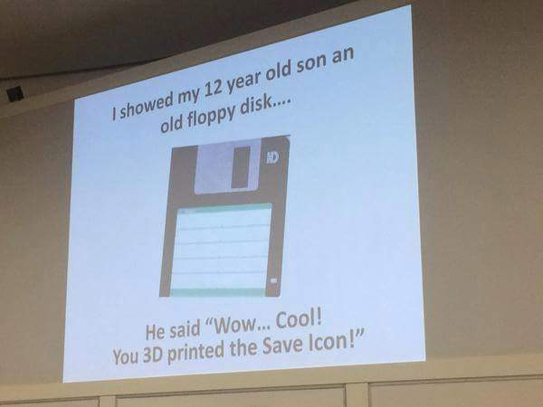

Slide 28



Slide 29


Conflict?
Cooperation?

Slide 31



Slide 32



Be Part of an Online Community

Slide 33
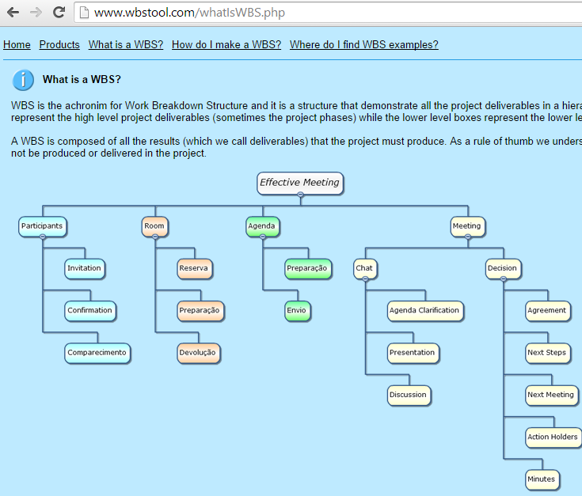
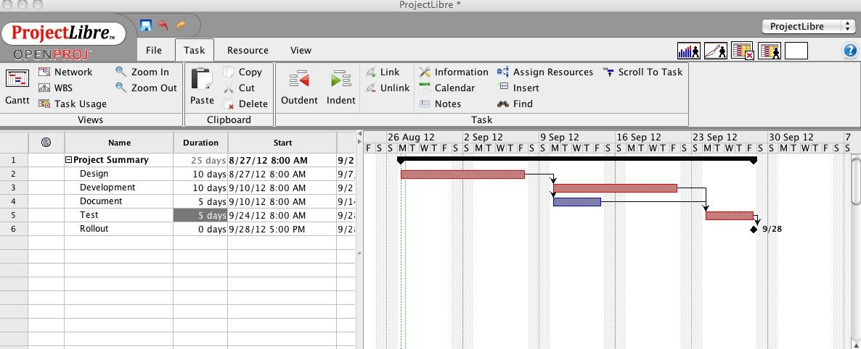
Try New Online and Open Source Tools!

Slide 34
Importance of Emotional intelligence

Slide 35
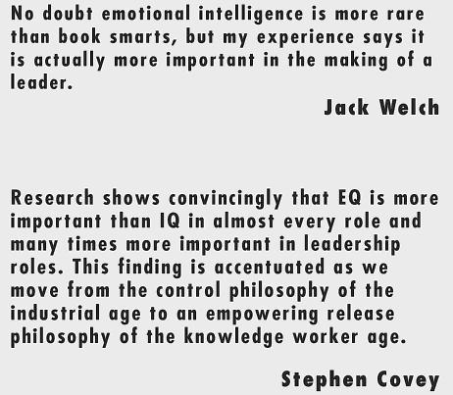
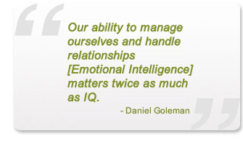
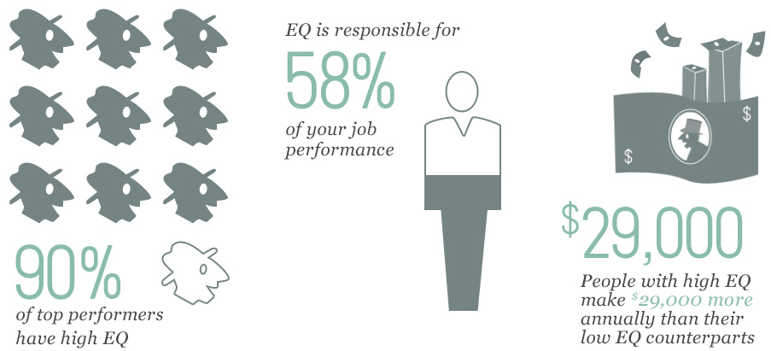
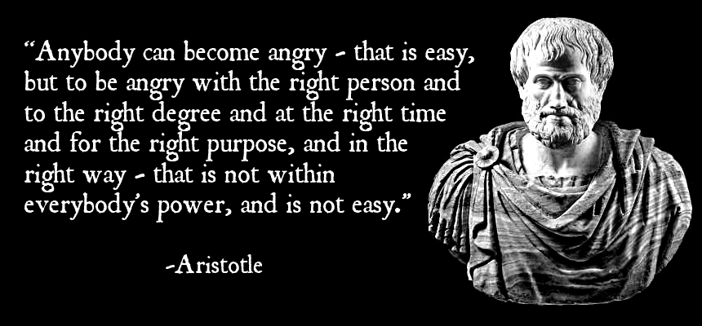
Notes:
Daniel Jay Goleman (born March 7, 1946) is an author, psychologist, and science journalist. For twelve years, he wrote for The New York Times, specializing in psychology and brain sciences. He is the author of more than 10 books on psychology, education, science, ecological crisis, and leadership.

Slide 36
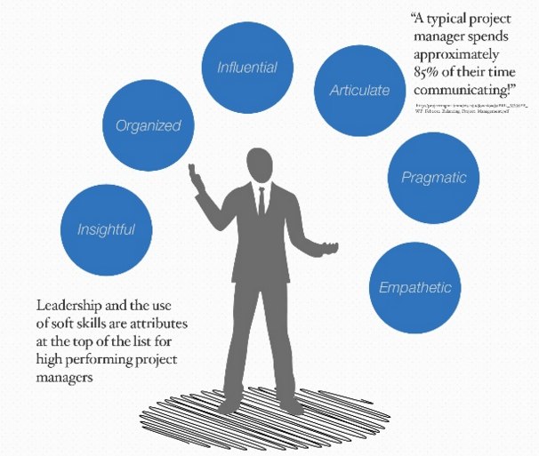

Slide 37



Notes:
EQ has a greater impact on success than other factors.
The ability to delay gratification is a primary indicator of future success.
High EQ leads to healthy relationships with others.

Slide 38
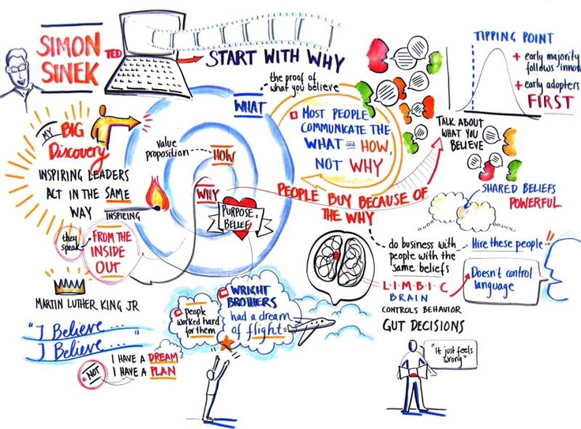

Slide 40
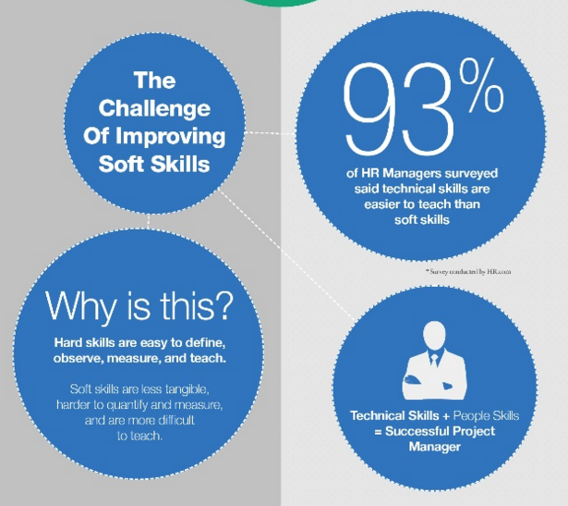

Slide 41

3-Steps to Developing EQ

Slide 42
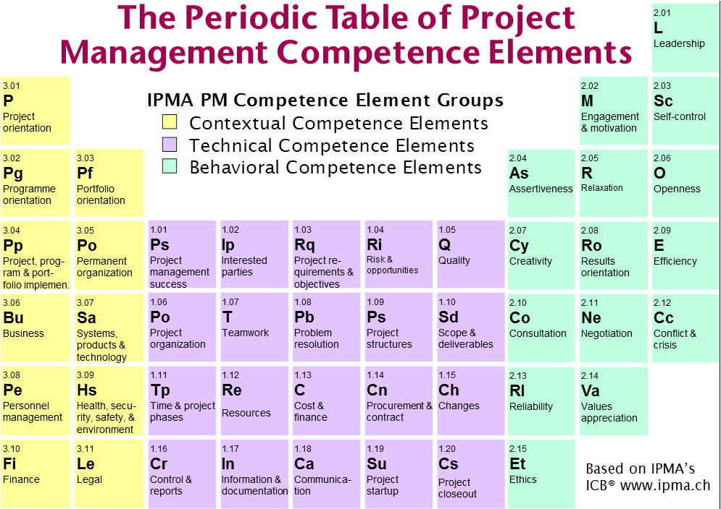

Slide 43

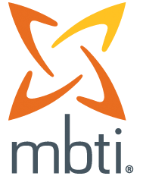
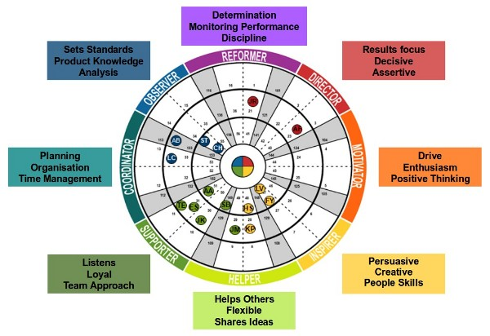
Check your personality

Slide 44

Practice in a Fail safe environment

Slide 46


PMs Build Culture
Policy (Organizational)
Project Culture (project level)
Notes:
“A pattern of basic assumptions formed by a group on how to perceive and address problems associated with both internal adaptation and external integration.”
Edgar Henry Schein, a former professor at the MIT Sloan School of Management

Slide 47


Slide 48
The Butterfly Effect in Practice

Slide 49

Butterfly Effect

Slide 50


Notes:
The current financial crisis is the worst the world has seen since the Great Depression of the 1930s.

Slide 52
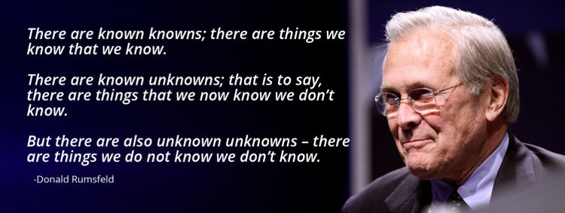
Risk Management

Slide 54
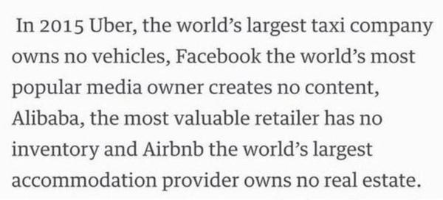
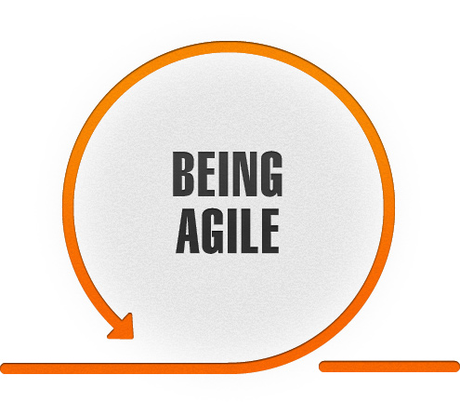

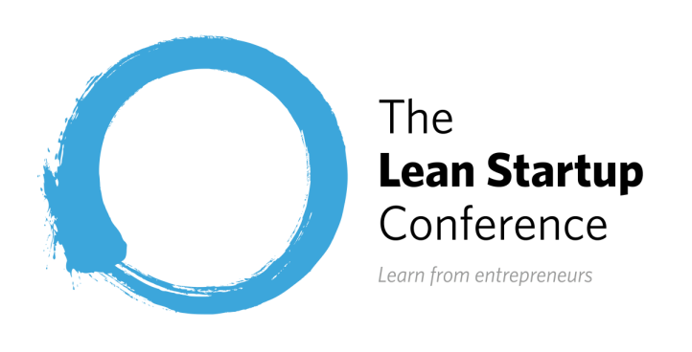

Slide 55
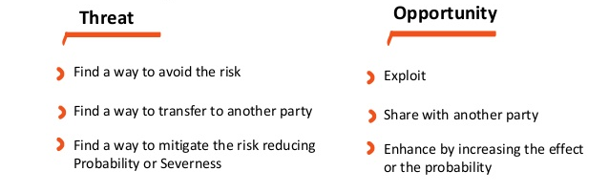
Risk Management

Slide 56

Who remembers what is my IPMA Project?

Slide 57


Notes:
There are two things in my life that I am very passionate about,
For over 8 years now, I have been volunteering in student clubs, community projects and non-for-profits because I believe deeply in that we have a responsibility to positively shape the community in which we live. This is something that I am passionate about. And seeing the results of creating positive social change is one of the most satisfying feelings in the world. Since I was an undergraduate student, I realized the value of such work, which has allowed me to help shape the community in which I found myself, and also has given me the opportunity to find leadership, personal development and networking opportunities, all while making a positive impact in the lives of others. This for me is the ‘win-win-win’ situation, which has defined my life and that I encourage other young leaders to follow this path of service.

Slide 58

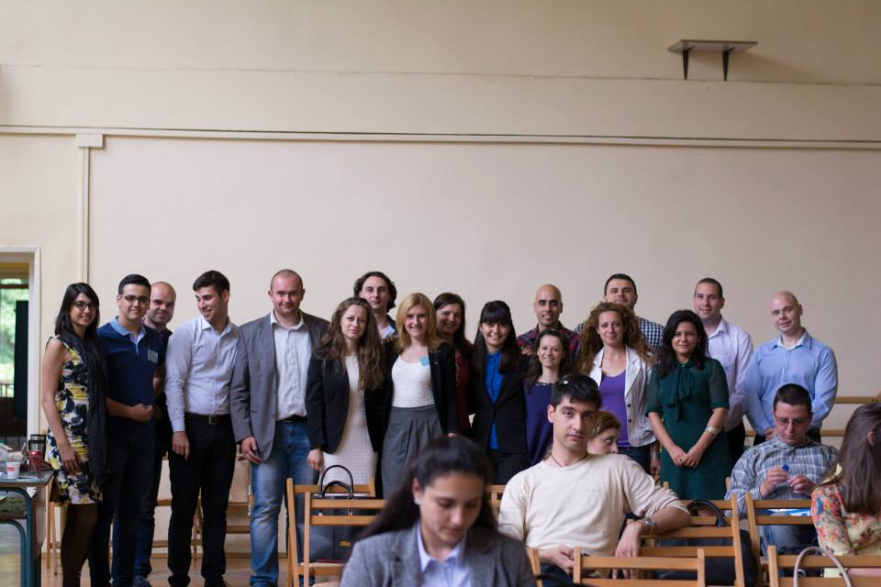
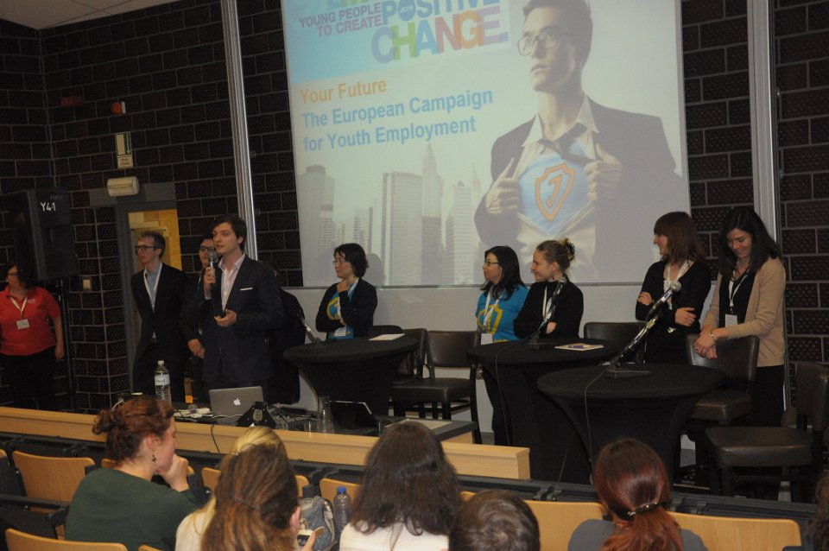



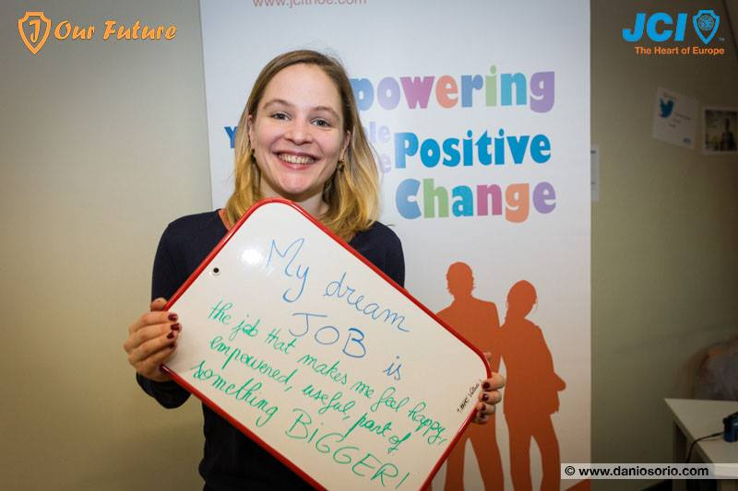
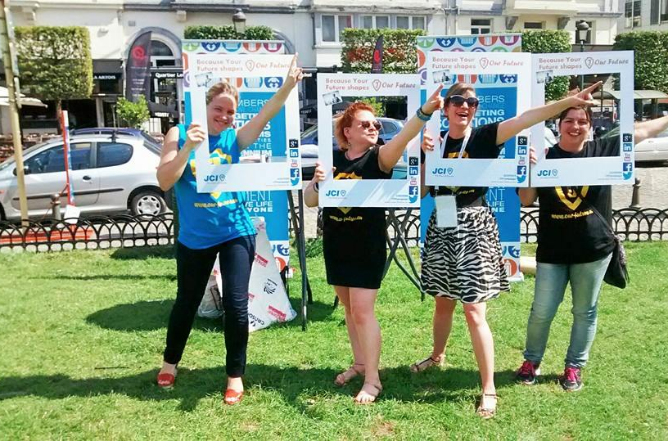

Inspiration, practical advice and mentorship in times of youth unemployment..

Slide 59
Be a Leader, not a Boss

Slide 60
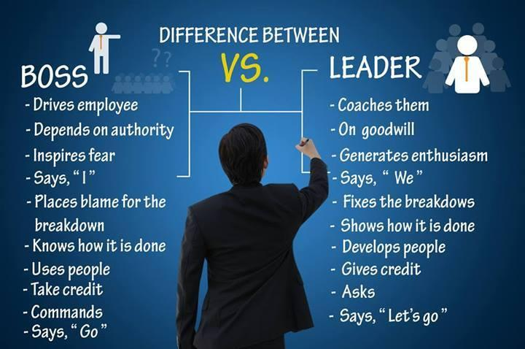

Slide 61
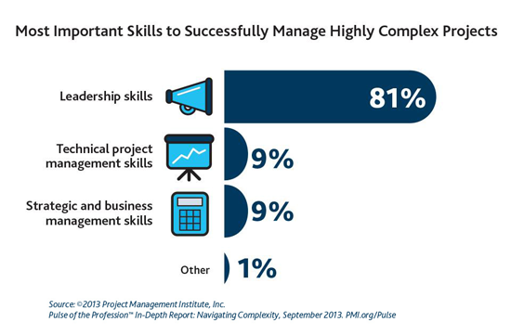

Slide 62

Be a Volunteer PM

Slide 63







Slide 64
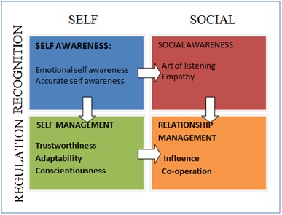
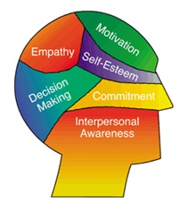
Emotional Intelligence

Slide 65




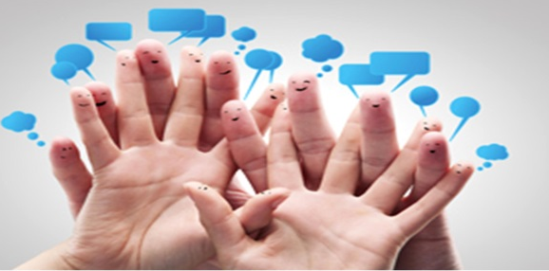
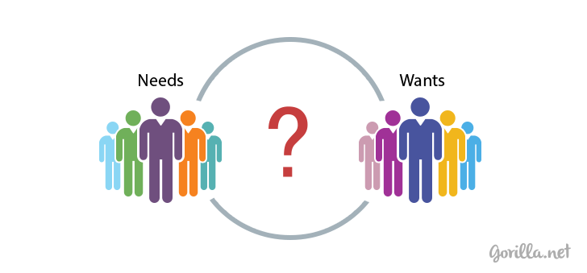
Notes:
With busy lives, it can be hard to find time to volunteer. However, the benefits of volunteering are enormous to you, your family, and your community. The right match can help you find friends, reach out to the community, learn new skills, and even advance your career. Volunteering can also help protect your mental and physical health. Learn more about the many benefits of volunteering and find tips on getting started as a volunteer.

Slide 66



Slide 67


Notes:
Join an organization where you can demonstrate your skills, competences and practice your project management skills
PMI Volunteering video: https://www.youtube.com/watch?v=xVV6DpgznvQ#t=18

Slide 68

Company Perspective
Notes:
Marc Benioff, CEO of Salesforce.com, promotes what he calls “the 1 per- cent solution”: 1 percent of the company’s equity, 1 percent of its profits, and 1 percent of its employees’ paid work hours are devoted to philanthropy.
Software maker SAS, which has for years been among the Top 20 in Fortune’s annual list of the 100 best companies to work for, offers a volunteer initiative that lets employees use flexible schedules to take paid time off for projects in the community, or even work in teams with their managers on a volunteer effort during business hours.
Throughout his career, Benioff has been determined to use information technology to produce positive social change. In July 2000, with Colin Powell in attendance, Benioff launched the salesforce.com/ foundation, a multi-million dollar global philanthropic organization aimed at bridging the digital divide. Pioneering the "1 percent solution" — salesforce.com contributes one percent of profits, equity and employee hours back to the communities it serves — the salesforce.com/foundation has demonstrated the power and impact of integrated philanthropy.

Slide 69

Tip # 6: Volunteering enabling a Sense of Service Leadership

Slide 70

Service Leadership
Lao-Tzu wrote about servant leadership in the fifth-century BC, he said:
A servant leader is someone who is a servant 1st
Has a responsibility to the world and his team
They contribute to the well-being of people and the community
Notes:
Who is a Servant Leader:

Slide 71


Slide 72


Slide 73


