Slide 1

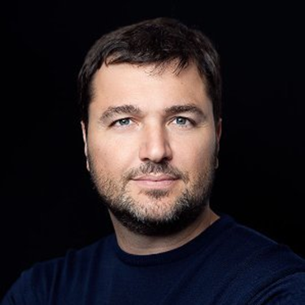
The UN Office for Project Services
and Its Unique Experience in the World of Humanitarian Projects
Ricardo Vargas
Director, Infrastructure and Project Management, United Nations Office for Project Services
20 November 2015

Slide 2
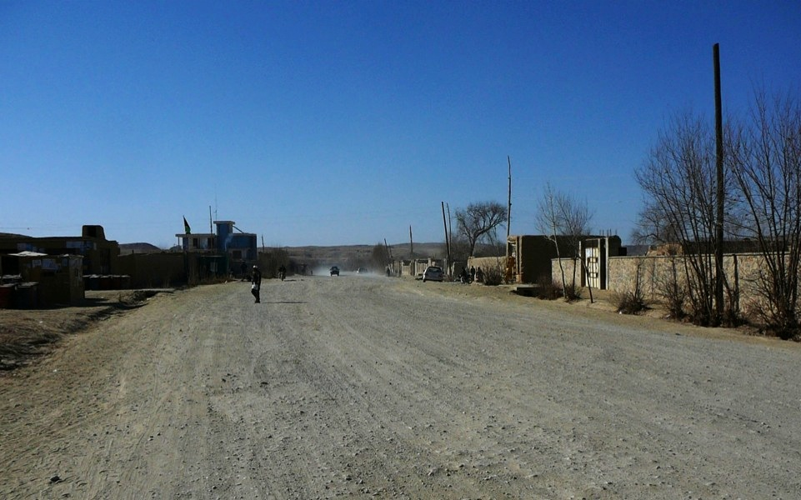
Chagcharan
Afghanistan
2009

Slide 3
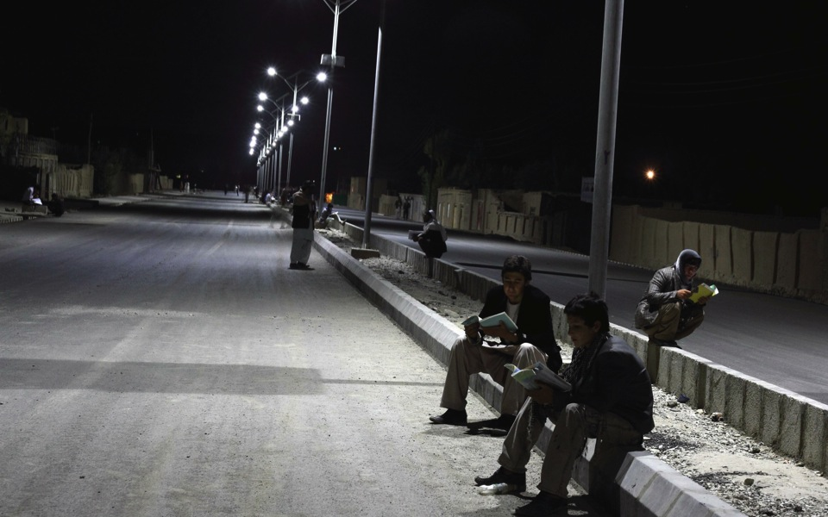
Chagcharan
Afghanistan
2011

Slide 4
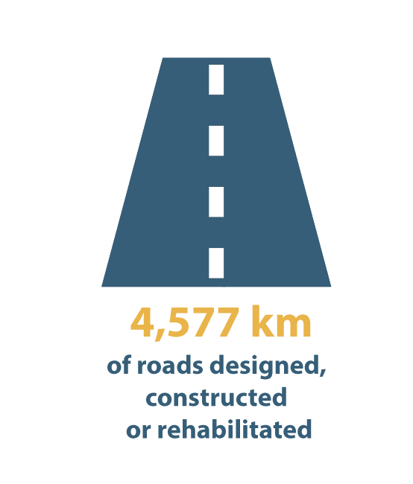


Slide 5
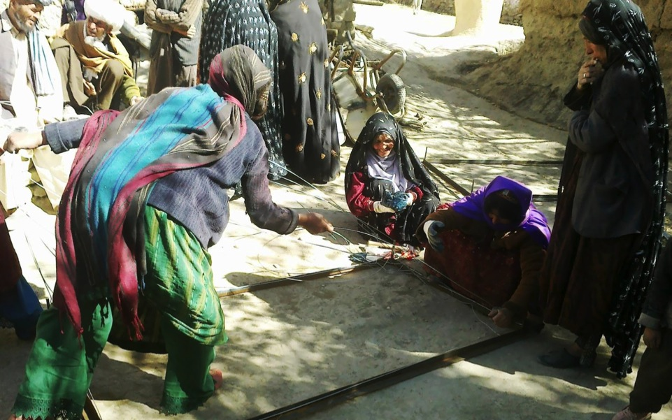
Engaging the Community

Slide 6
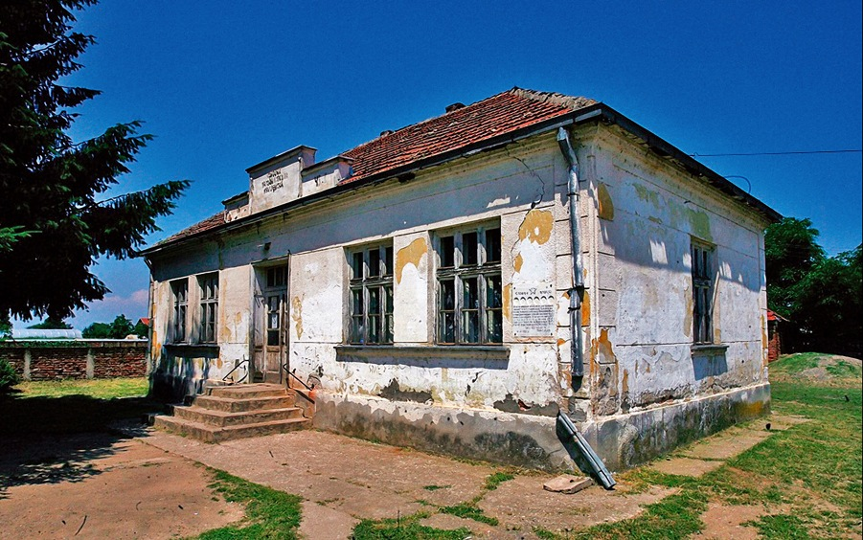
Serbia
Before

Slide 7
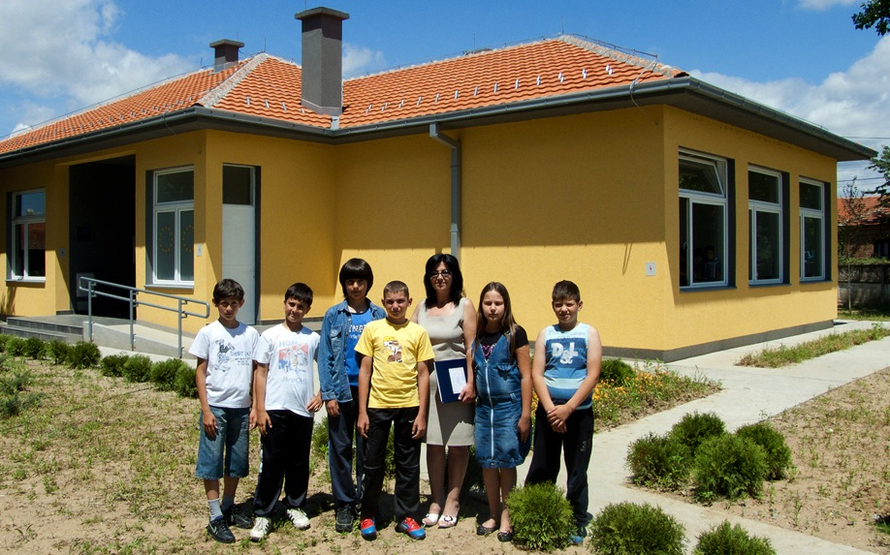
Serbia
After

Slide 8

30
SCHOOLS and
CONSTRUCTED OR REHABILITADED
01
UNIVERSITY

Slide 9
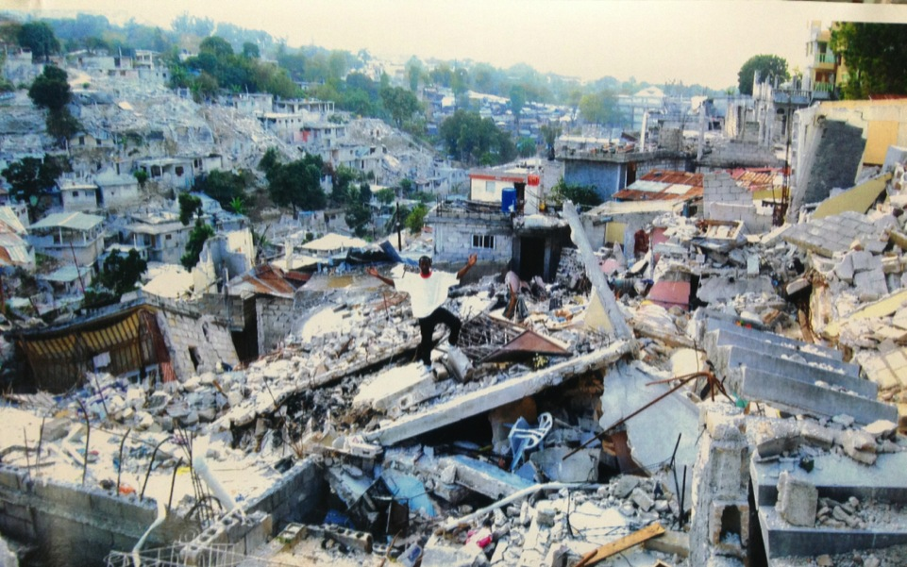
Port au Prince
Haiti
2010

Slide 10
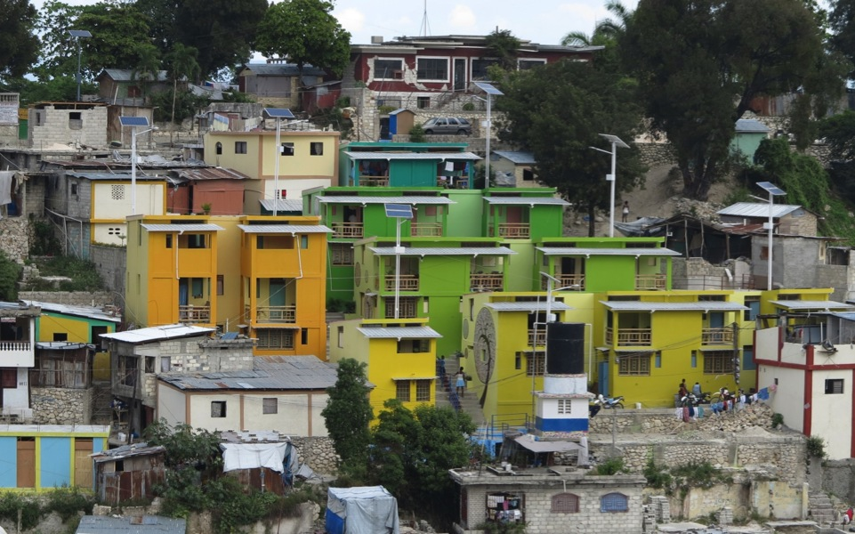
Port au Prince
Haiti
2013

Slide 11
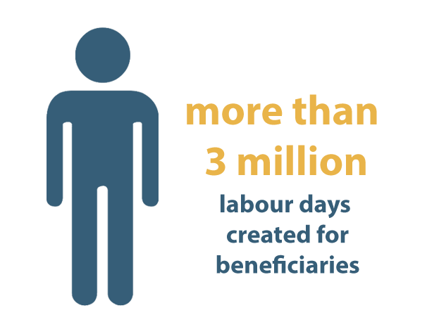

Slide 12
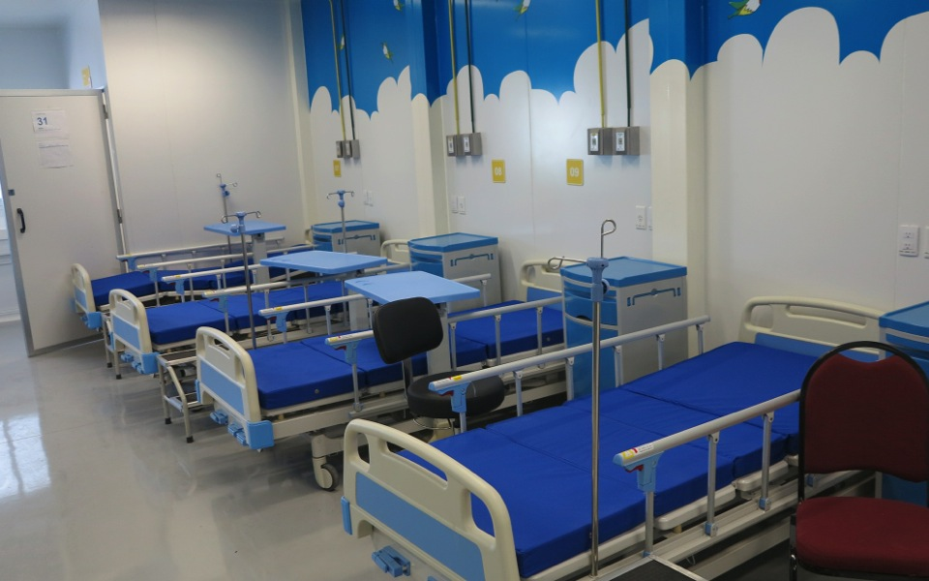
Port au Prince
Haiti
2013

Slide 13
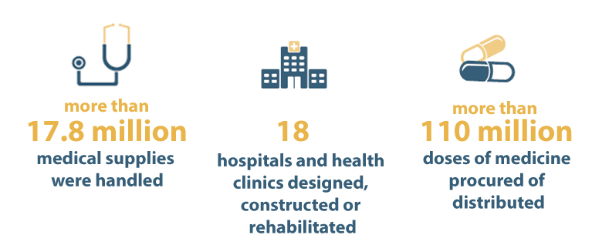

Slide 14
What is unops?
Operational arm of the United Nations
  Support sister UN Agencies, Governments, NGOs in three main areas
SUSTAINABLE
INFRASTRUCTURE
PROCUREMENT
PROJECT MANAGEMENT

Slide 15
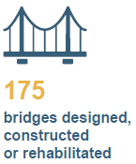

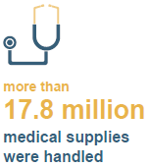
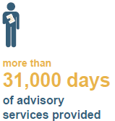
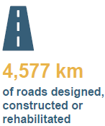
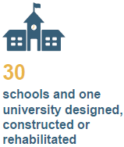
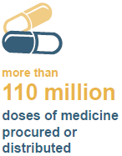
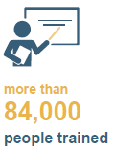
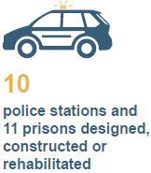
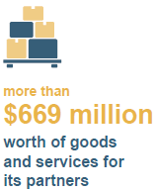
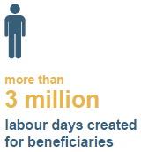
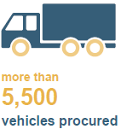
KEY RESULTS

Slide 16
1,249
>250
PROJECTS
IMPLEMENTED
PROJECT
MANAGERS
On behalf of partners

Slide 17
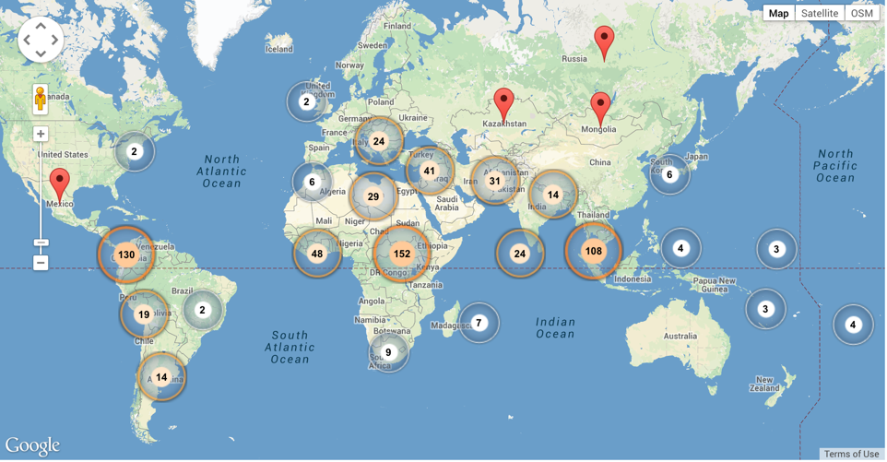
Where we work (2014)

Slide 18
Sustainable PM

Slide 19
Sustainable Project Management
But what does “Sustainable” Project Management means?
Aim of results + How we implement
1
AIM
Projects and programmes comply to strict criteria concerning environmental and social scope and planned results before they are initiated.
2
HOW
Our teams embed
cross-cutting initiatives,
such as how to get the best community support,
into their project planning
and implementation phases.

Slide 20
Sustainable Project Management
PROJECT MANAGEMENT
PM
Project Management
Strategic Portfolio Office
Best Practices
Services & Delivery
I
Infrastructure
P
Procurement

Slide 21
Sustainable Project Management
PROJECT MANAGEMENT
PM
Project Management
STRATEGIC PORTFOLIO OFFICE
  Oversight UNOPS Portfolio
  Plans, prioritization, strategy support
  Field Missions
  Engagement Acceptance
I
Infrastructure
P
Procurement

Slide 22
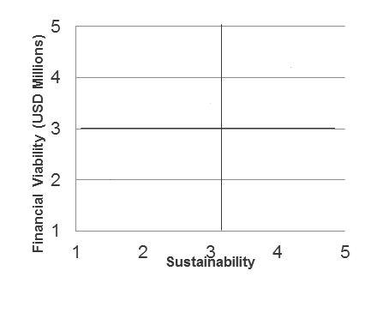
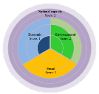
Sustainability Marker and gri
Maximizing the sustainability potential of our partner’s projects
National capacity
Score: 2
Economic
Score: 1
Environmental
Score: 2
Where we should be headed
Social
Score: 3

Slide 23
Sustainable Project Management
PROJECT MANAGEMENT
PM
Project Management
BEST PRACTICES
  Methodology
  Tools
  Training
  Community engagement
  Gender
I
Infrastructure
P
Procurement

Slide 24
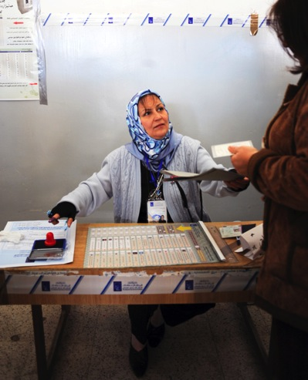
Gender Toolkit
  Guidelines and guidance to include gender aspects in all UNOPS projects
  Aligned with UNOPS Project Management methodology
  Case Studies

Slide 25
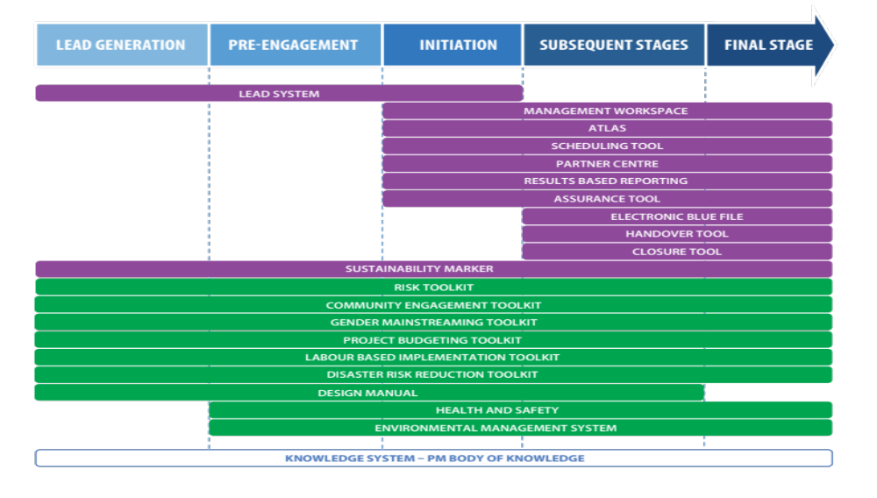
Project Management Tools

Slide 26
Sustainable Project Management
PROJECT MANAGEMENT
PM
Project Management
SERVICES DELIVERY
  Advisory services
  PM Online Training
  Project Planning
  Project Office Implementation
I
Infrastructure
P
Procurement

Slide 27




Global Credentials
UNOPS continuously benchmarks against external bodies, striving for external certifications of processes and adopting internationally recognized best practices and standards.

Slide 28
2014 Project Management Work (SPMPG)
  Support projects in 123 countries
  More than 450 new projects (leads) evaluated per year
  Capacity building workshops with more than 2700 people attending the workshops in 30 countries
  160 UNOPS Project Managers trained this year and 415 in the UNOPS Certified Project Manager Program
  PM Online Training for UNOPS and partners with more than 1810 students attending in French, Spanish, English and Arabic

Slide 29
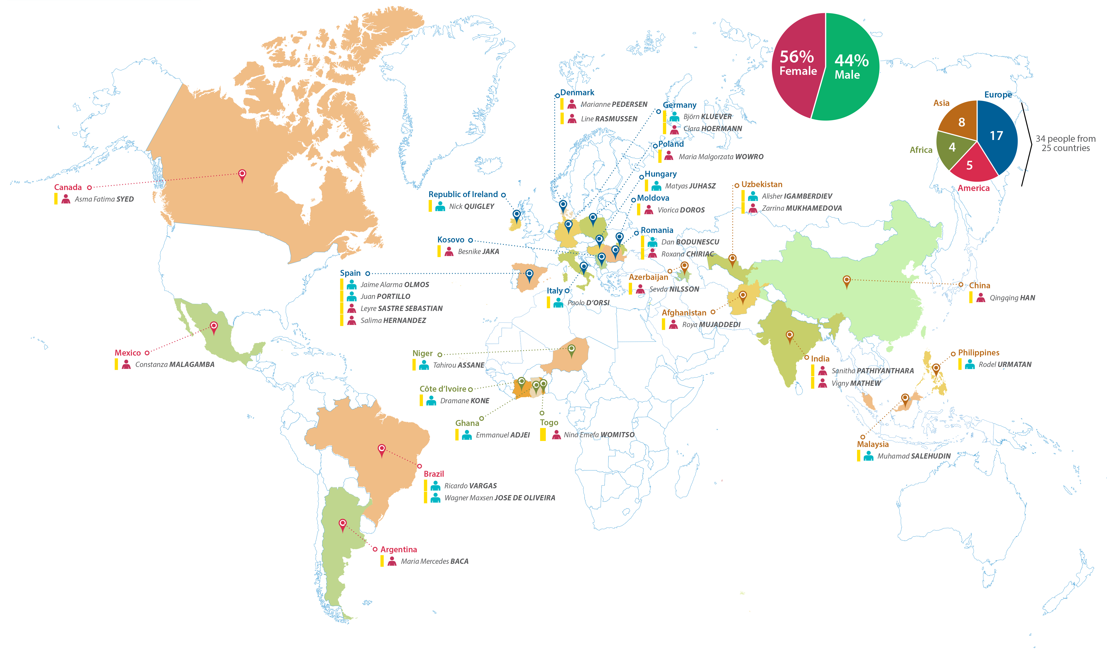
Our Team – 25 countries

Slide 30
What makes our
projects different?

Slide 31
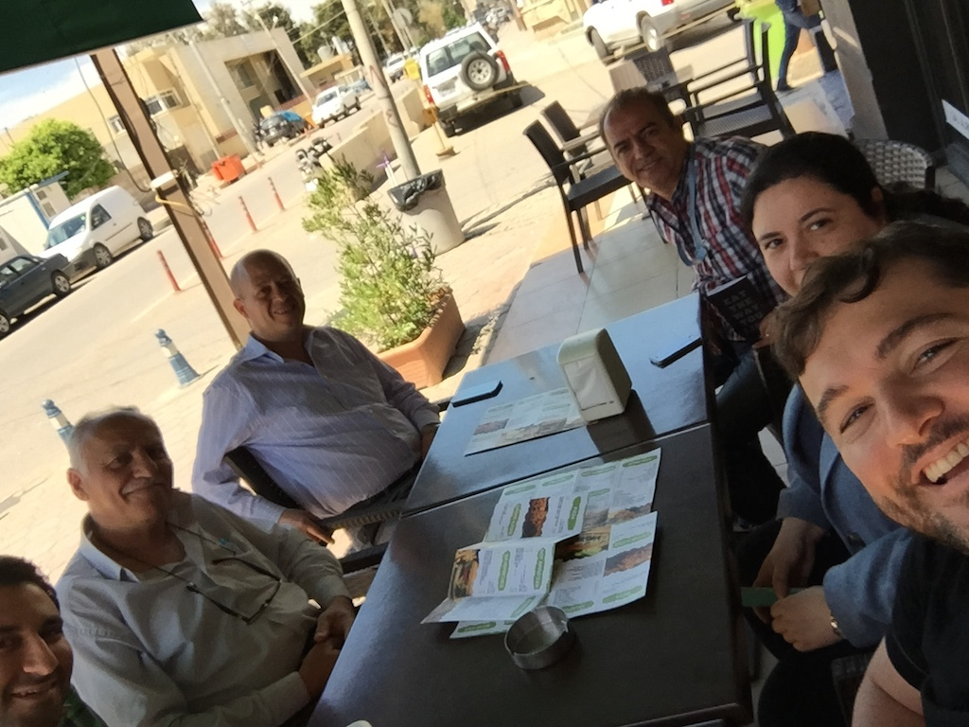
Erbil – Kurdistan - Iraq
15/04/2015 - 13:20
Ainkawa Café

Slide 32
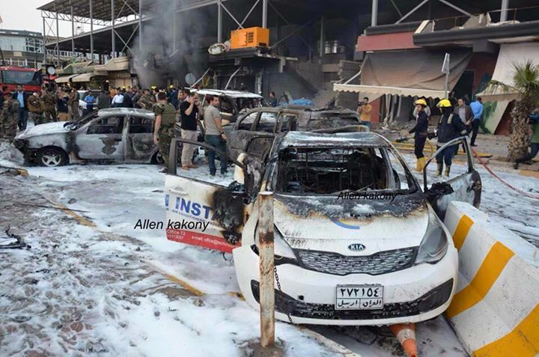
Erbil – Kurdistan - Iraq
17/04/2015 - 17:40
Ainkawa Café

Slide 33
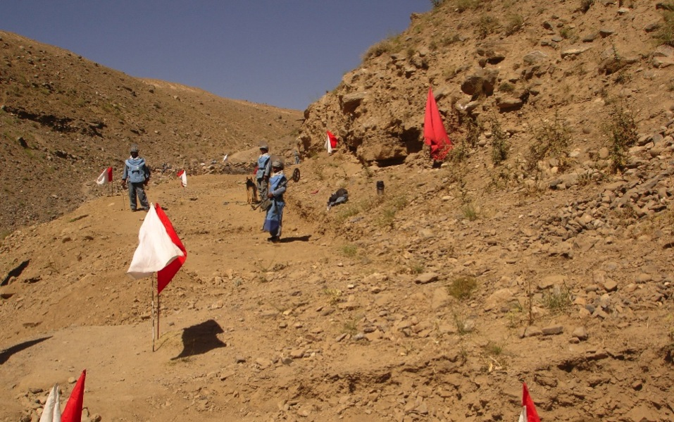
Post Conflict / Disaster Conditions

Slide 34
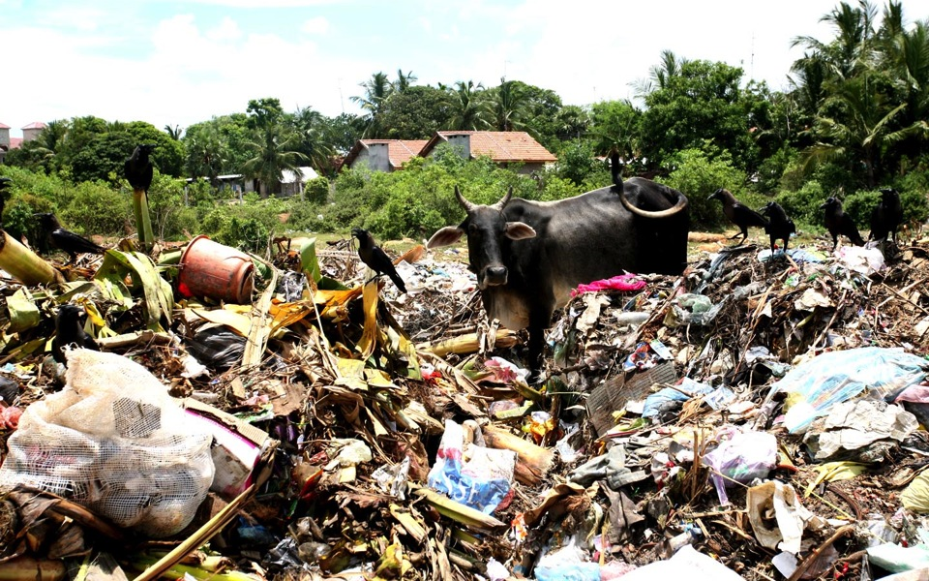
Post Conflict / Disaster Conditions

Slide 35

Remote
Locations

Slide 36
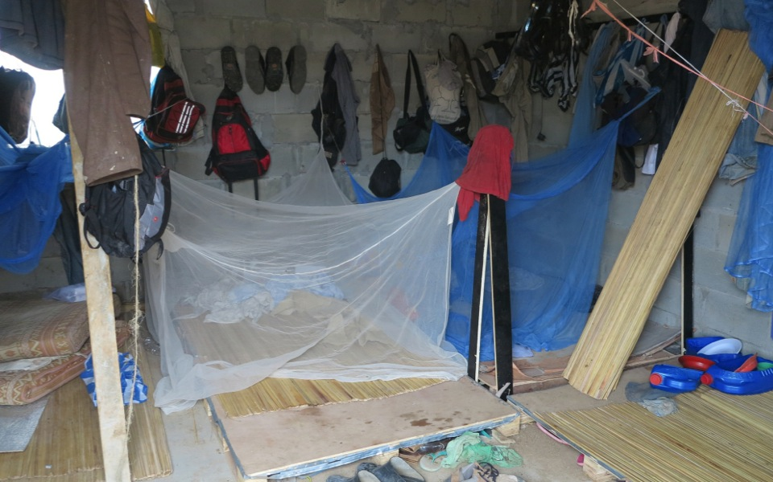
Extreme Work Conditions

Slide 37
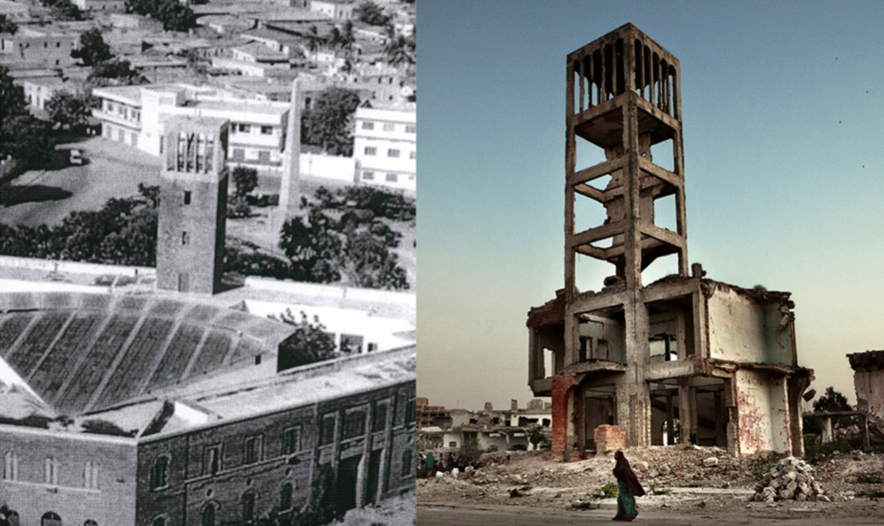
Instability

Slide 38
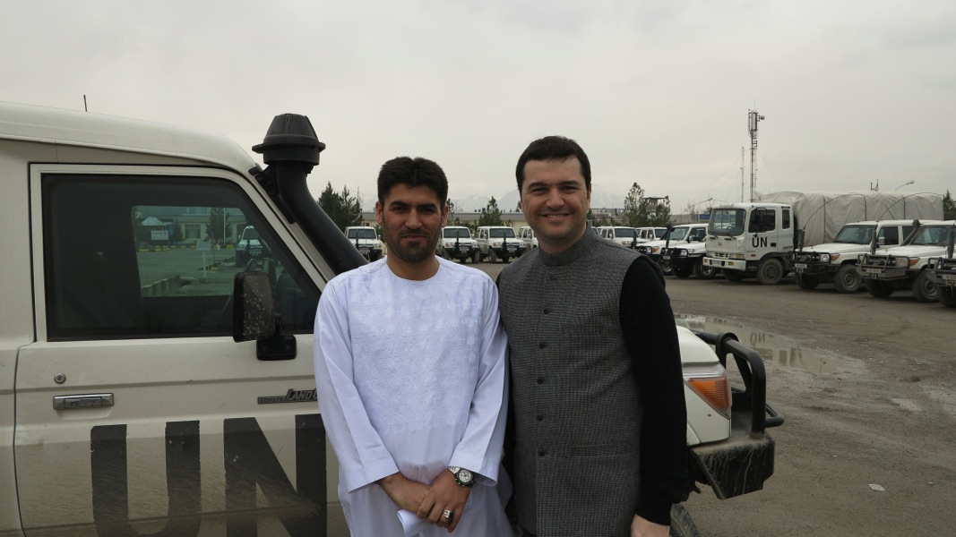
Cultural Diversity

Slide 39
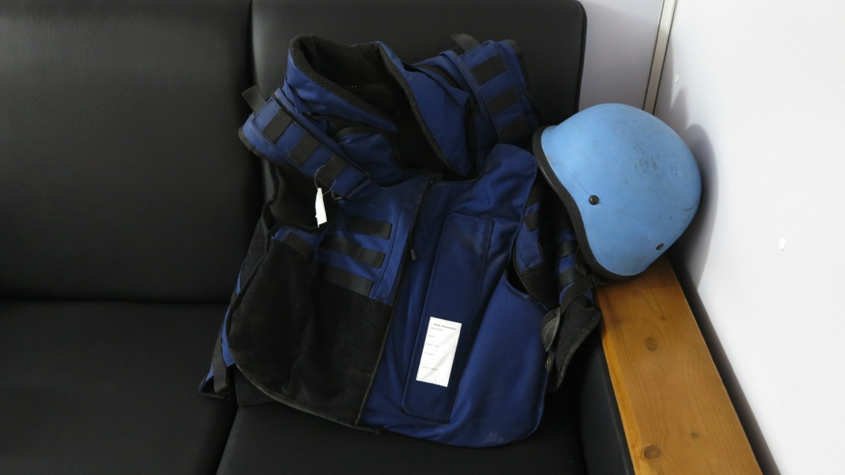
Staff Safety

Slide 40
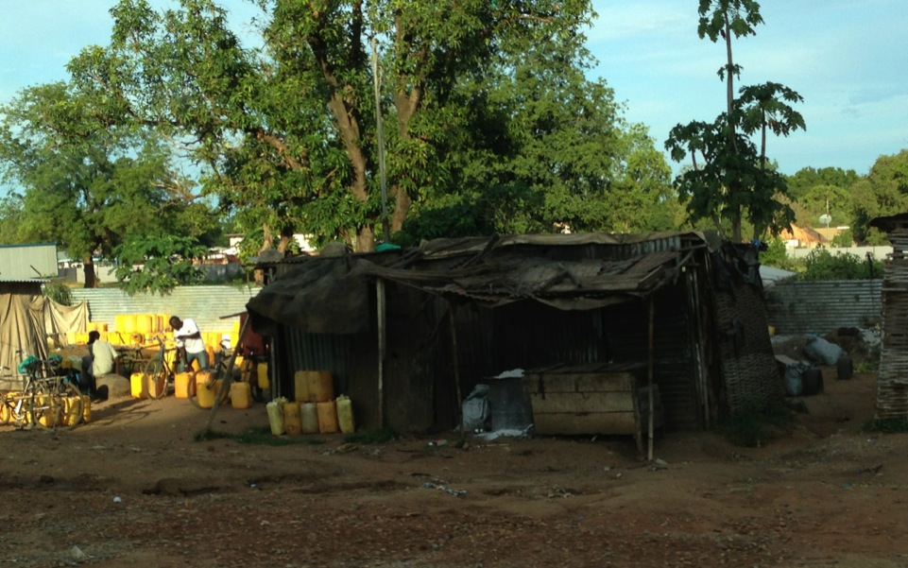
Logistics and Local Infrastructure

Slide 41
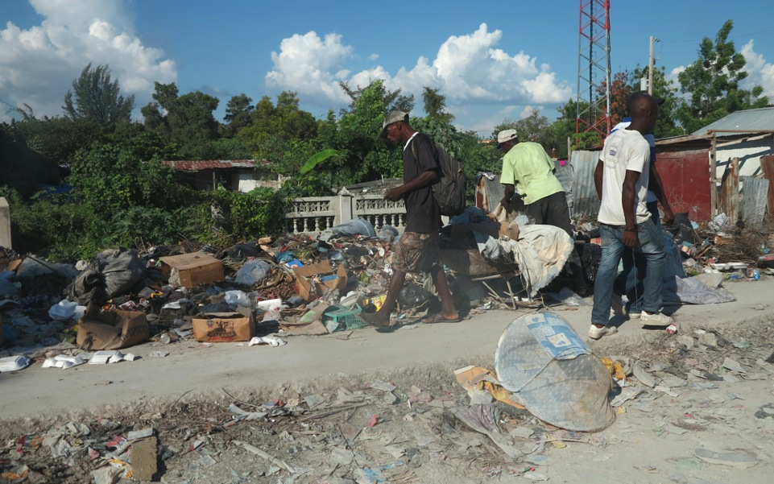
Poverty

Slide 42
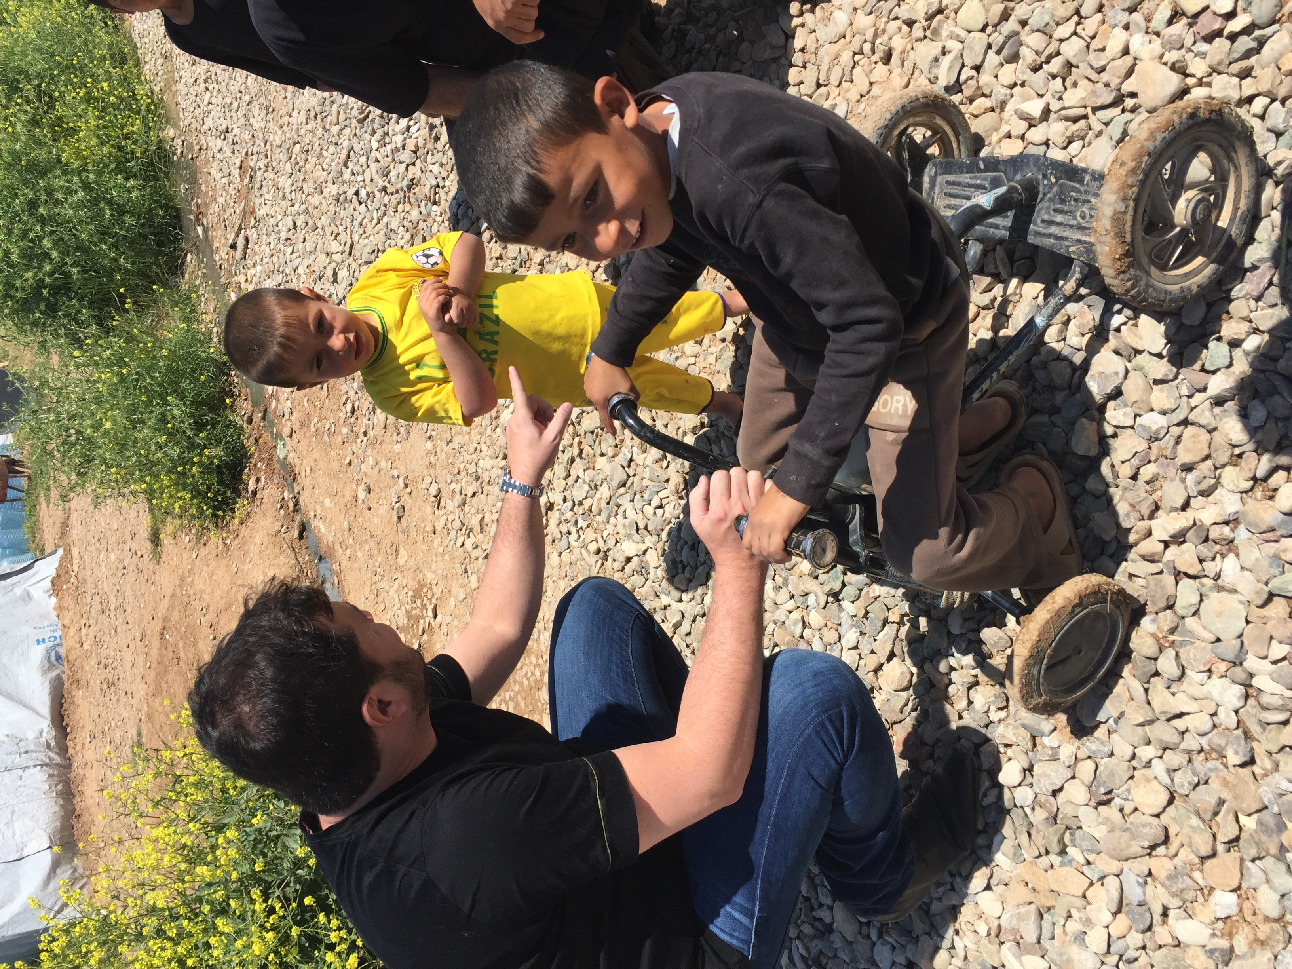
How We Address Complexity? 5 Believes
1
The is no perfect solution. Done is better than perfect.
2
It is impossible to wait for stability to start working.
3
Problems will happen. We need to be prepared to handle them.
4
Think long term but act in the short term.
5
Get the most out of limited resources.

Slide 43
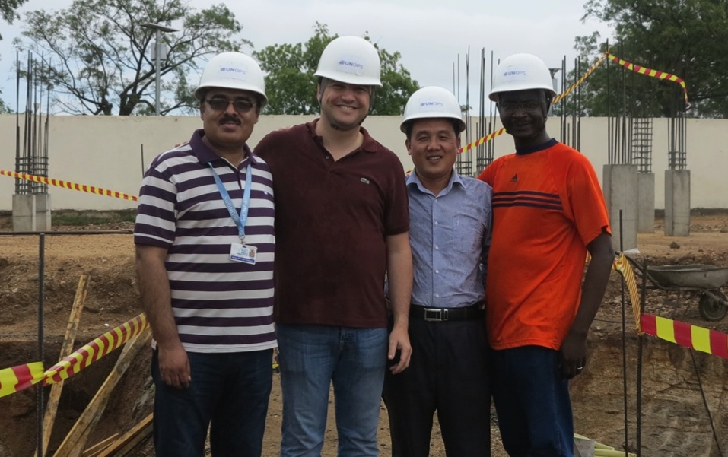

Many thanks! ricardov@unops.org
@rvvargas

Slide 44
Better projects, better lives
UNOPS Sustainable Project Management Practice Group

